Slide 1
Supporting Students with Dyslexia in the Classroom
Kim Stuckey
Kim.Stuckey@dese.mo.gov

Slide 3
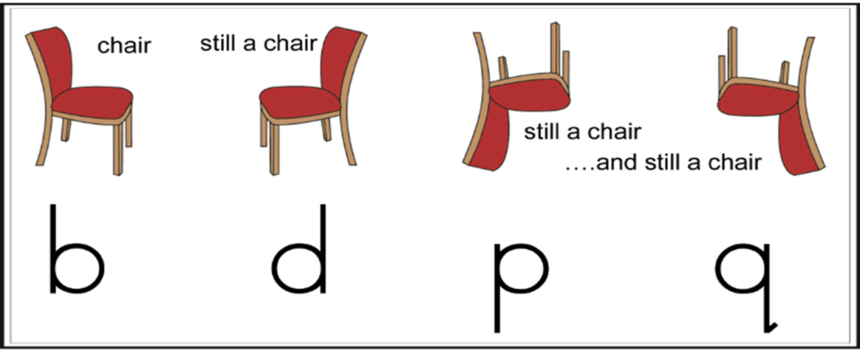
Debunking the Myths
Myth: People with dyslexia see letters or words backwards.
Fact: Dyslexia is an issue with processing and manipulating language.

Slide 5
Pre and Post Intervention

Slide 6
Myth: IQ = Skilled Reader
Fact:

Slide 7
Myth: Dyslexia is an not an eligibility category under IDEA.
Fact: Dyslexia is listed as a Specific Learning Disability in IDEA, 2004. Sec. 300.8(c)(10) Specific learning disability. (i) General. Specific learning disability means a disorder in one or more of the basic psychological processes involved in understanding or in using language, spoken or written, that may manifest itself in the imperfect ability to listen, think, speak, read, write, spell, or to do mathematical calculations, including conditions such as perceptual disabilities, brain injury, minimal brain dysfunction, dyslexia, and developmental aphasia.
Note: IEE Diagnosis does replace eligibility process.

Slide 8
Dyslexia is..
• a specific learning disability
• neurobiological in origin
• characterized by difficulties with accurate and/or fluent word recognition and by poor spelling and decoding abilities
• difficulties typically result from a deficit in the phonological component of language
• difficulties often unexpected in relation to other cognitive abilities and the provision of effective classroom instruction
• secondary consequences may include problems in reading comprehension and reduced reading experience that can impede growth of vocabulary and background knowledge.
IDA/NICHD, 2002

Slide 9
Elementary Characteristics
Delayed speech
Mixing up sounds and syllables
Confusion over directionally based words
Late establishing a dominant hand
Difficulty learning to tie shoes, tell time
Trouble with the concept of rhyming
Poor Spelling

Slide 10
Trouble following multi-step directions
Difficulty learning a new word even after multiple teachings
Word Retrieval
Trouble memorizing
Processing Speed
Working Memory

Slide 11
Reading Aloud
Guesses based on shape (house/horse, breakfast/basket)
Correct sounds, incorrect sequence (from/form, stop/spot, was/saw, who/how, lots/lost) may use semantic substitution (speed/fast, puppy/dog)
Inserts or omits sounds (could/cold, stream/steam,
Skips or misreads prepositions
Ignores suffixes (even/evening, come/coming)
Poor decoding skills
Confuses vowel sounds (bat/bet/bit)
Letter and number reversals beyond second grade

Slide 12
Trouble with Math
math facts,
multiple steps
directionality
Handwriting
Grip, spacing, strokes
Getting ideas onto paper
Dread of going to school?

Slide 13
One in Five
Dyslexia and all its inherent characteristics exist on a spectrum.
No two students will look exactly alike.

Slide 14
Related Strengths
Problem-Solving
Sees the “big picture”
“Out-of-the-box” Thinker
Strong verbal, people skills
Creative, artistic, musical
Visual-Spatial strengths
Often gifted in math, technical skills, mechanical or computing
(source; webmd.com)

Slide 15
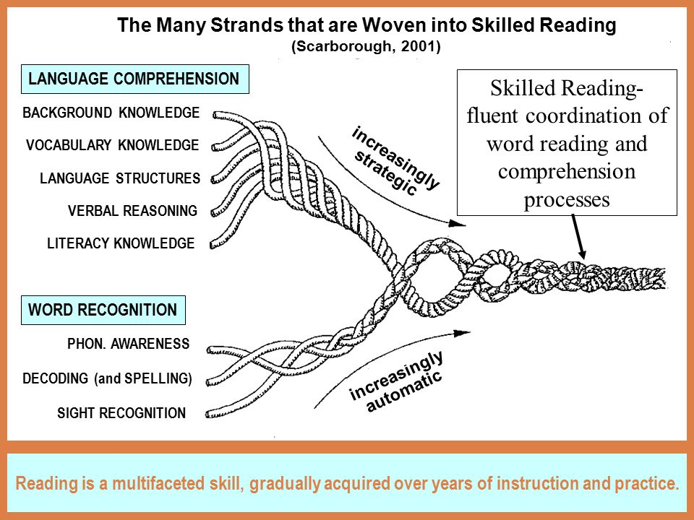

Slide 16
The Big Five
Phonological Awareness
Phonics
Fluency
Vocabulary
Comprehension

Slide 17
Reading Readiness Skills
Phonemic Awareness is the CORE and CAUSAL factor that separates normal readers from disabled readers.” -G. Reid Lyon
Phonemic Awareness
Alphabet Knowledge
Sound/Symbol Correspondence
Spelling
Rapid Automatic Naming
Word Reading and Decoding
Real and Nonsense words

Slide 18
Define
Phonics
Phonemic Awareness
Phonological Awareness

Slide 19
Phonological Awareness
Levels of PA development
Continuum; large skills to small
Syllable
Basic to Advanced
Onset-Rime
Basic to Advanced
Phoneme
Basic to Advanced
Equipped for Reading Success, 2016)

Slide 20
Developmental Stages
Syllable Level (including alliteration and rhyming)
Pre-K to Second Grade
Onset-Rime Level
Late Kindergarten to Second Grade
Basic Phoneme Level
Early Second to Fourth (or Never)
Advanced Phoneme Level
Often Never
(Equipped for Reading Success, 2016)

Slide 21
Let’s Try This!

Slide 22
What’s Next?
Explicit and Systematic
Phonics
Introduction of letters to the sounds already taught
Syllable Patterns
Closed
Open
Consonant –le
Silent –e (six reasons)
Vowel Team
Vowel –r
Notes:
Silent-e; teaching rime units is helpful shove, love, glove, above
But doesn’t work for move and prove, this is where etymology is important

Slide 23
Morphology
Smallest units of meaning; prefixes, bases, suffixes
Spelling
Letter and sounds come together in consistent patterns for pronunciation and meaning
Taught in combination with phonics/reading, not as separate memorization tasks
(Henry, 2010)
Irregular Words
unexpected letters for sounds (said, friend)
word origin (one, once, two)
https://www.youtube.com/watch?v=0mbuwZK0lr8

Slide 24
What about Etymology?
Explore Greek and Latin Roots
Sources: Word Works and Real Spelling
wordworkskingston.com
realspelling.fr
Word Origin
etyomonline.com

Slide 26
Goal Reading by Sight
Sight Word
Familiar word that is recognized instantly, automatically, effortlessly
Sight Vocabulary
All the words we know instantly and automatically
(Equipped for Reading Success, p.27)

Slide 27
Screening

Slide 28
Screening Skills
Universal K-3
Phonological Awareness
RAN
Word Reading and Decoding
Letter/Sound Knowledge
Spelling
Fluency/Comprehension
Determining an “at-risk” profile

Slide 29
Considerations
Now and Future
What assessments/measures currently in use?
What data does it provide?
Is that data detailed enough?
Who is sharing the data?
What will the interpretation of the data mean in the way of determining the next steps?
How will progress be monitored?
Integration with RtI/MTSS?

Slide 30
Supports
and Accommodations

Slide 32
Learning Considerations
What is the learning objective that is being measured?
What alternative ways can the student demonstrate mastery?
How can the student access grade level content?
How can learning be a positive experience?
What is the school climate regarding accommodations?

Slide 33
Extra Time and..
Oral Testing/Designated reader
Audio Books; Learning Ally or BookShare
Large Print, Simple fonts
Limited item per page
Oral instructions with written instructions
List of procedures
Graphic Organizers
Large projects broken into smaller steps

Slide 34
Reduce copying tasks.
Speech-to-text software
Recorded lectures
Copies of Notes
Extra space for handwriting
No penalization for spelling errors
Allow for dictated/typewritten homework
Exemption from reading aloud/spelling contests
Avoid Reading/Writing as punishment

Slide 35
Math
Untimed Tests
Calculator for math facts
Order or operations, list of steps necessary, functions
Graph paper for alignment
Reading support for extracting necessary information from word problems
Watch for: Transpositions, reversals, inversions

Slide 36
Science/Social Studies
Spelling
Vocabulary
Names of Processes; confusing similar terms, word retrieval, names, dates
Recall: Visual/Conceptual Strengths
Tactile Learners
Try: Project Based Learning, Scribe, Oral Testing, Word Banks

Slide 37
Timeline
House Bill 2379/SB 638 (signed June 22, 2016)
Final Report
October 31, 2017
State Board Meeting
Report Release
3 Mandates
6 Additional Recommendations
December 31, 2017
Guidance
School Year 2018-2019
Mandatory Screenings for students
Subsequent Accommodations
2 Hours of PD for all teachers-yearly

Slide 39
Tell us what you think!
https://www.surveymonkey.com/r/OCCREvaluation

Slide 40
Thank you!
Kim Stuckey
573-751-2584
kim.stuckey@dese.mo.gov
Edmodo Group Code: fsj36g

Slide 41
Resources
Bowers, Peter, How the Written Word Works, 2010
Henry, Marcia, Unlocking Literacy, 2nd Ed., 2010
Kilpatrick, David, Equipped for Reading Success, 2016
Kilpatrick, David, Essentials of Assessing, Preventing and Overcoming Reading Difficulties, 2015
Selznick, Richard, Dyslexia Screening, 2015

Slide 42
References
Begintoread.com; http://www.begintoread.com/research/ literacystatistics.html
Ehri, Linnea; Development of Sight Word Reading: Phases and Findings, The Science of Reading, A Handbook, Chapter 8, Blackwell Publishing, 2005.
Dehaene, Stanislas, Reading in the Brain, 2010.
www.dys-add.com, Bright Solutions for Dyslexia
Gaab, Nadine, thegaablab.com/publications.html
Henry, Marcia, Unlocking Literacy, 2nd Ed. 2010
International Dyslexia Association www.eida.org
Kilpatrick, David, Equipped for Reading Success, 2016
Kilpatrick, David, Essentials of Assessing, Preventing and Overcoming Reading Difficulties, 2015

Slide 43
References
Lyon, Reid, International Dyslexia Association Keynote, 2009
Moats, Louisa, Reading is Rocket Science, 1999
National Center for Learning Disabilities, www.ncld.org
Pegado, Felipe,; Nakamura, Kimihiro,; Hannagan, Thomas, How does literacy break mirror invariance in the visual system, Frontiers in Psychology, July 2014
Shaywitz, Sally; Overcoming Dyslexia, 2003
Selznick, Richard; Dyslexia Screening, 2015
Torgesen, Joseph K, Avoiding the Devastating Downward Sprial, www.aft.org/periodical/american-educator/fall-2004/avoiding-devasting-downward-sprial

