Slide 1
Evaluating Principals
Making a Fuzzy Process More Clear
J Anderson
Brady Quirk
Bret Range
Notes:
J

Slide 2
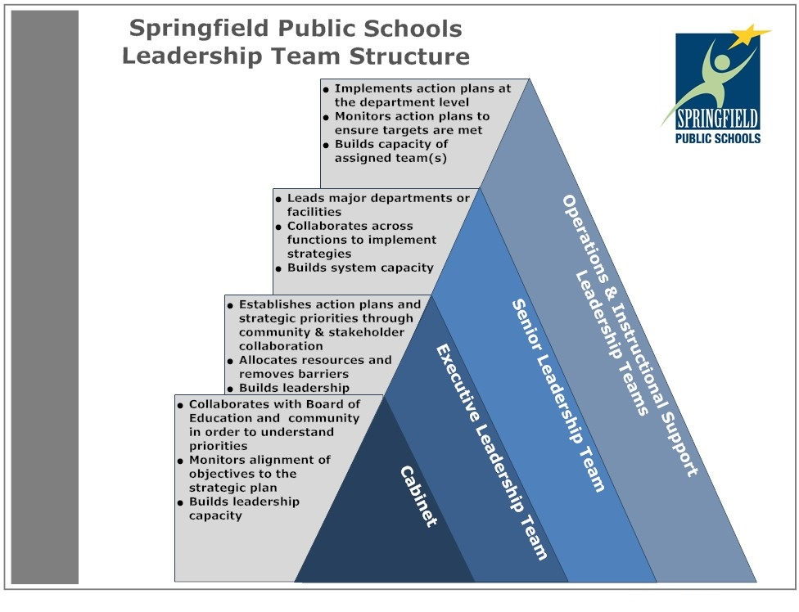
SPS Context
25,000 students
36 Elementary Schools (Four K-8 )
Cabinet (5 members)
Executive Leadership Team
Directors
Notes:
J

Slide 3
Background
Teacher impact on learning
Leadership impact on teachers
Instructional leadership
Formative supervision vs. summative evaluation
Notes:
Bret

Slide 4
Principal Supervisor Standards
Dedicate time to help principals grow as instructional leaders
Coach, support, and engage in effective professional learning
Use evidence of effectiveness to determine necessary improvements
Engage principals in evaluation processes
Inform the vision, policies, and strategies to support learning
Encourage schools are culturally/socially responsive
Engage in their own improvement
Lead change
Notes:
There ARE standards for principal supervisors….Council of Chief City School Officers standards issued in 2015
Not necessarily a focus, but a great starting point to get that mindset
Highlight first three

Slide 5
Missouri Model Principal Evaluation
AUGUST-SEPTEMBER:
Identify indicators to be assessed
6 standards, 13 indicators
Determine baseline scores for indicators
Develop a growth plan for indicators
Notes:
How many use the Mo Model or a modified version of it?
Here is the recommended 7 -step process W/ timeline
Go thru initial steps
Growth plan is the foundation and the focus
Pull up doc/list of S & I’s - updated ISLLC

Slide 6
Growth Plans = Foundation & Focus
District emphasis and personal choice -emphasis
WHY - WHAT - HOW
Self Assess utilizing rubrics - score 0-7
EMERGING / DEVELOPING / PROFICIENT / DISTINGUISHED

Slide 7
Missouri Model Principal Evaluation
OCTOBER-MARCH : Provide feedback on indicators
Mid-Year Growth plan check
APRIL-MAY: Determine a follow-up score on indicators
Complete summative - Meets/Growth Opportunity/Concern
MAY-AUGUST: Reflect and plan
Notes:
Frequent Meaningful Feedback - we don’t typically conduct “observations” - look at evidence more closely in a moment
Added step of mid year check
EOY self assessment
Demo of Summative
Demo feedback?
In order for this to all work, P’s must have an understanding of some guiding questions...

Slide 8
Guiding Questions
Do principals clearly understand all standards and indicators?
How do we get a clear, holistic picture of principals’ performance?
How do we collect objective rather than subjective data?
How do best connect data to each standard and indicator?
How do we ensure principals have a voice in their evaluation?
How can we use the standards and indicators as reflection points for principals?
How can we ensure the evaluation process is perceived as fair?
Notes:
J

Slide 9
Data Sources
Student achievement scores
Teacher/patron survey results
Professional learning meeting agendas
Discipline rates
Classroom visit numbers
Budget expenditures
School/community partnerships
Evidence of shared decision making
Evidence of service to the district and profession
Monthly site visits
Daily/weekly e-mails
Notes:
Bret

Slide 10
Elementary Learning Model
Notes:
J

Slide 11
Evaluation within 1 Standard; 1 Indicator
Standard 2: Teaching and Learning, Indicator 2: Provide Effective Instructional Program
Instructional focus/School Action Plan (SAP)
Professional learning plan
Agendas, staff feedback, formative assessments
Classroom visits
Low performing teachers
Notes:
J

Slide 12
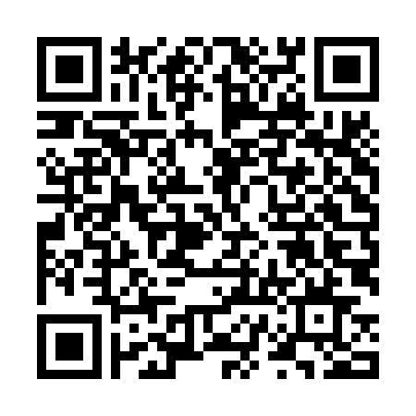
Closure
Questions?
bgrange@spsmail.org
Notes:
Bret

