Slide 1
Genius Hour
Building Passionate Learners
Bobby McCutcheon
Principal, Randall Elementary
Independence School District
@fight4mizzou and @RandallElementary

Slide 2
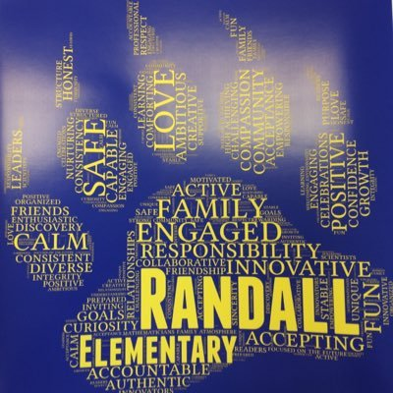
About our school...
Bobby McCutcheon (13 years in public education; 8 years admin)
Principal, Randall Elementary, Independence School District
~85% Free/Reduced; Diverse student population
PK-5 building; 300 students (275 K-5).
Highly Transient Population

Slide 3
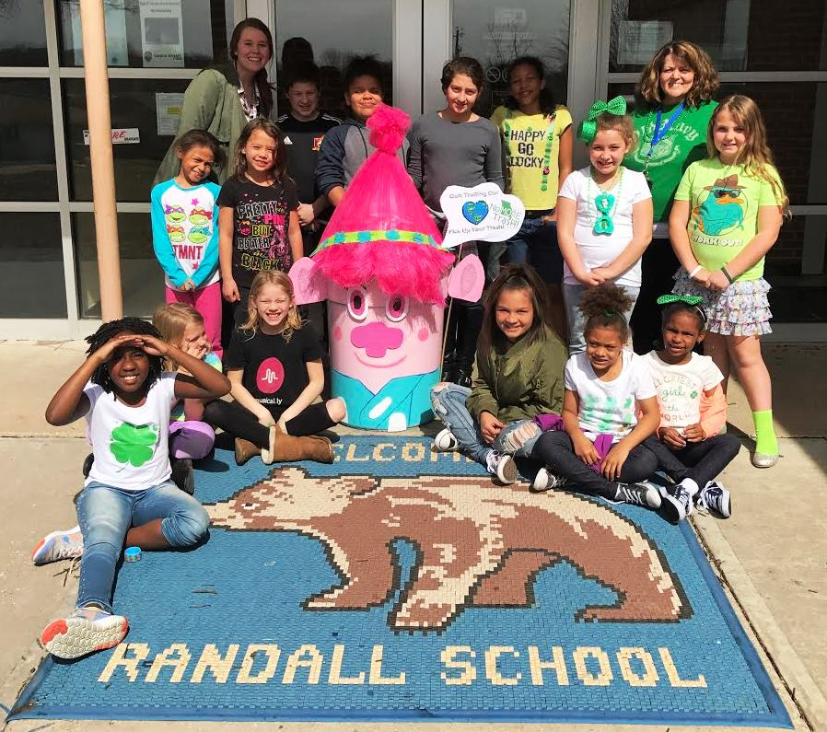
About our School
Serve one of the largest subsidized housing subdivisions in the Midwest (nearly 2,000 residents).
High levels of trauma and crisis
Our students face limited exposure to anything beyond our neighborhood.

Slide 4
Our Agenda
the PURPOSE, the PLAN, the PROJECTS

Slide 5
Are YOU a Genius?

Slide 6
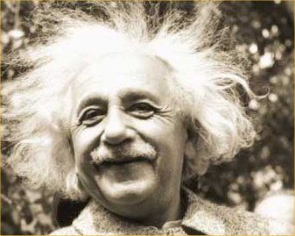
Yes!!!

Slide 7
Genius Hour
Choice Time
Project-Based Learning
20% Time
Passion Projects
What is Genius Hour?

Slide 8
Genius Hour is...
It is a place where students learn by DOING and CREATING!
Genius Hour is about self-discovery and the pursuit of CURIOSITY!
It is about PASSION!

Slide 9
Genius Hour is...
Students self-select projects based on these three questions:
What is YOUR passion?
What INSPIRES you?
What gets you EXCITED?

Slide 10
Students work on their projects over the course of 9-12 weeks culminating in a Genius Hour Showcase.

Slide 11
the PURPOSE
Promotes high-levels of CRITICAL THINKING and PROBLEM SOLVING SKILLS.
Engages students and helps them identify their PASSIONS, creating lifelong learners.
Teaches students 21st century RESEARCH skills .

Slide 12
the PURPOSE
Promotes high levels of STUDENT COLLABORATION
Makes learning FUN AND RELEVANT

Slide 13
the PURPOSE
Helps students see beyond their own neighborhood.
Exposes students to new opportunities and possibilities.

Slide 14
the PURPOSE
...did you miss the slide about increasing scores on your state assessment?

Slide 15
the PURPOSE
“One of the key benefits of a passion-based project is that students learn how to love learning.”
Don Wettrick

Slide 16
http://www.startedupinnovation.com/

Slide 17
the PLAN
Meet 45 minutes every Friday (9 week cycles).
Grades 3-5
Additional support staff--Reading Specialist and Literacy Tech. Integrationist.

Slide 18
the PLAN
Four Academies:
Randall Service
Randall STEM (1 and 2)
Randall Spark
Randall STAR

Slide 19
the PLAN
Only requirement for participation is that students must have all classwork, reading logs, and homework complete for the week.

Slide 20
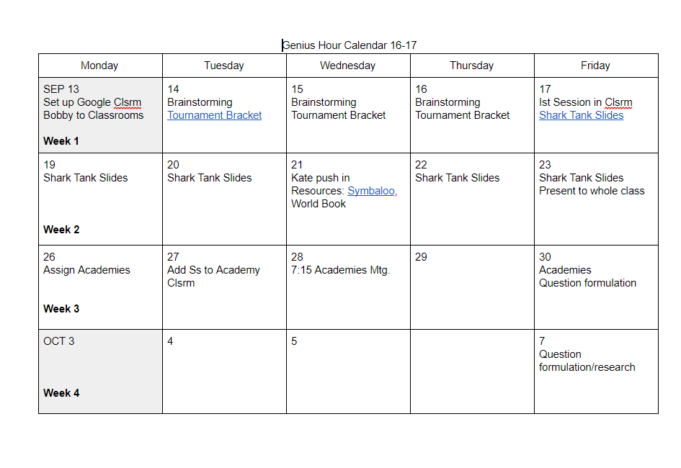

Slide 21
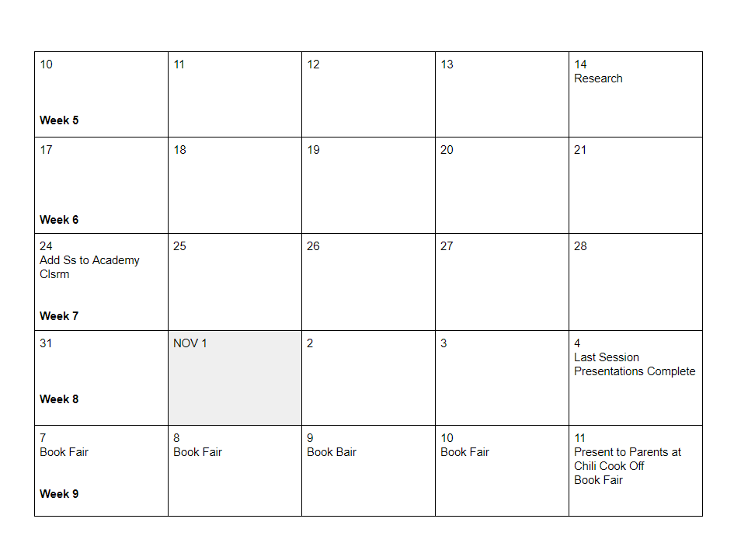

Slide 22
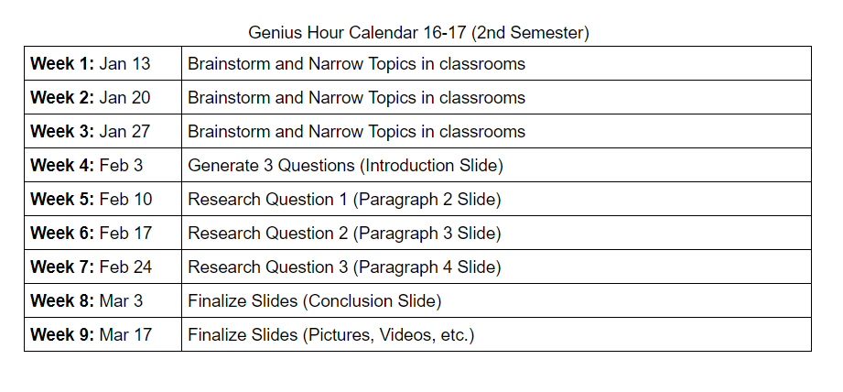
the PLAN

Slide 23
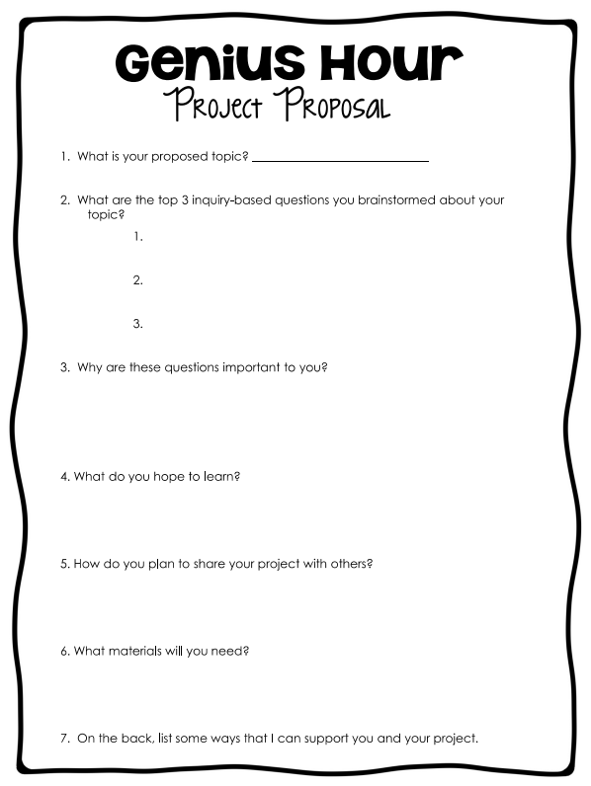
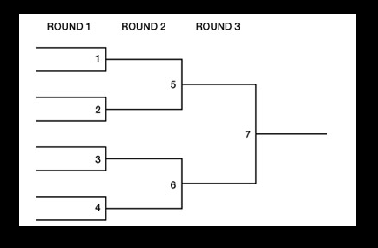
the PLAN - Selecting Topics

Slide 24
the PLAN
Should you assign a grade for Genius Hour?
What are students REQUIRED to do?

Slide 25
Genius Hour Covenant:
I WILL pursue MY interests and not be influenced by those around me.
I WILL utilize ALL available resources to become an expert in my field.
I WILL inquire of my academy teacher whenever a question arises or I am “stuck”.
I WILL support my academy classmates in their research whenever possible.
I WILL learn something during Genius Hour that I didn’t know before.

Slide 26
the Plan - Genius Hour Club
After School Club
Meets weekly for an hour
Open to students in grades 4-5
Major benefit is that it doesn’t disrupt your class schedule

Slide 27
the PROJECTS
Volleyball/MAP Night
Choreographing a Dance
Training Police Dogs
Free Youth Sports Camps
Making Scarves for the Needy

Slide 28
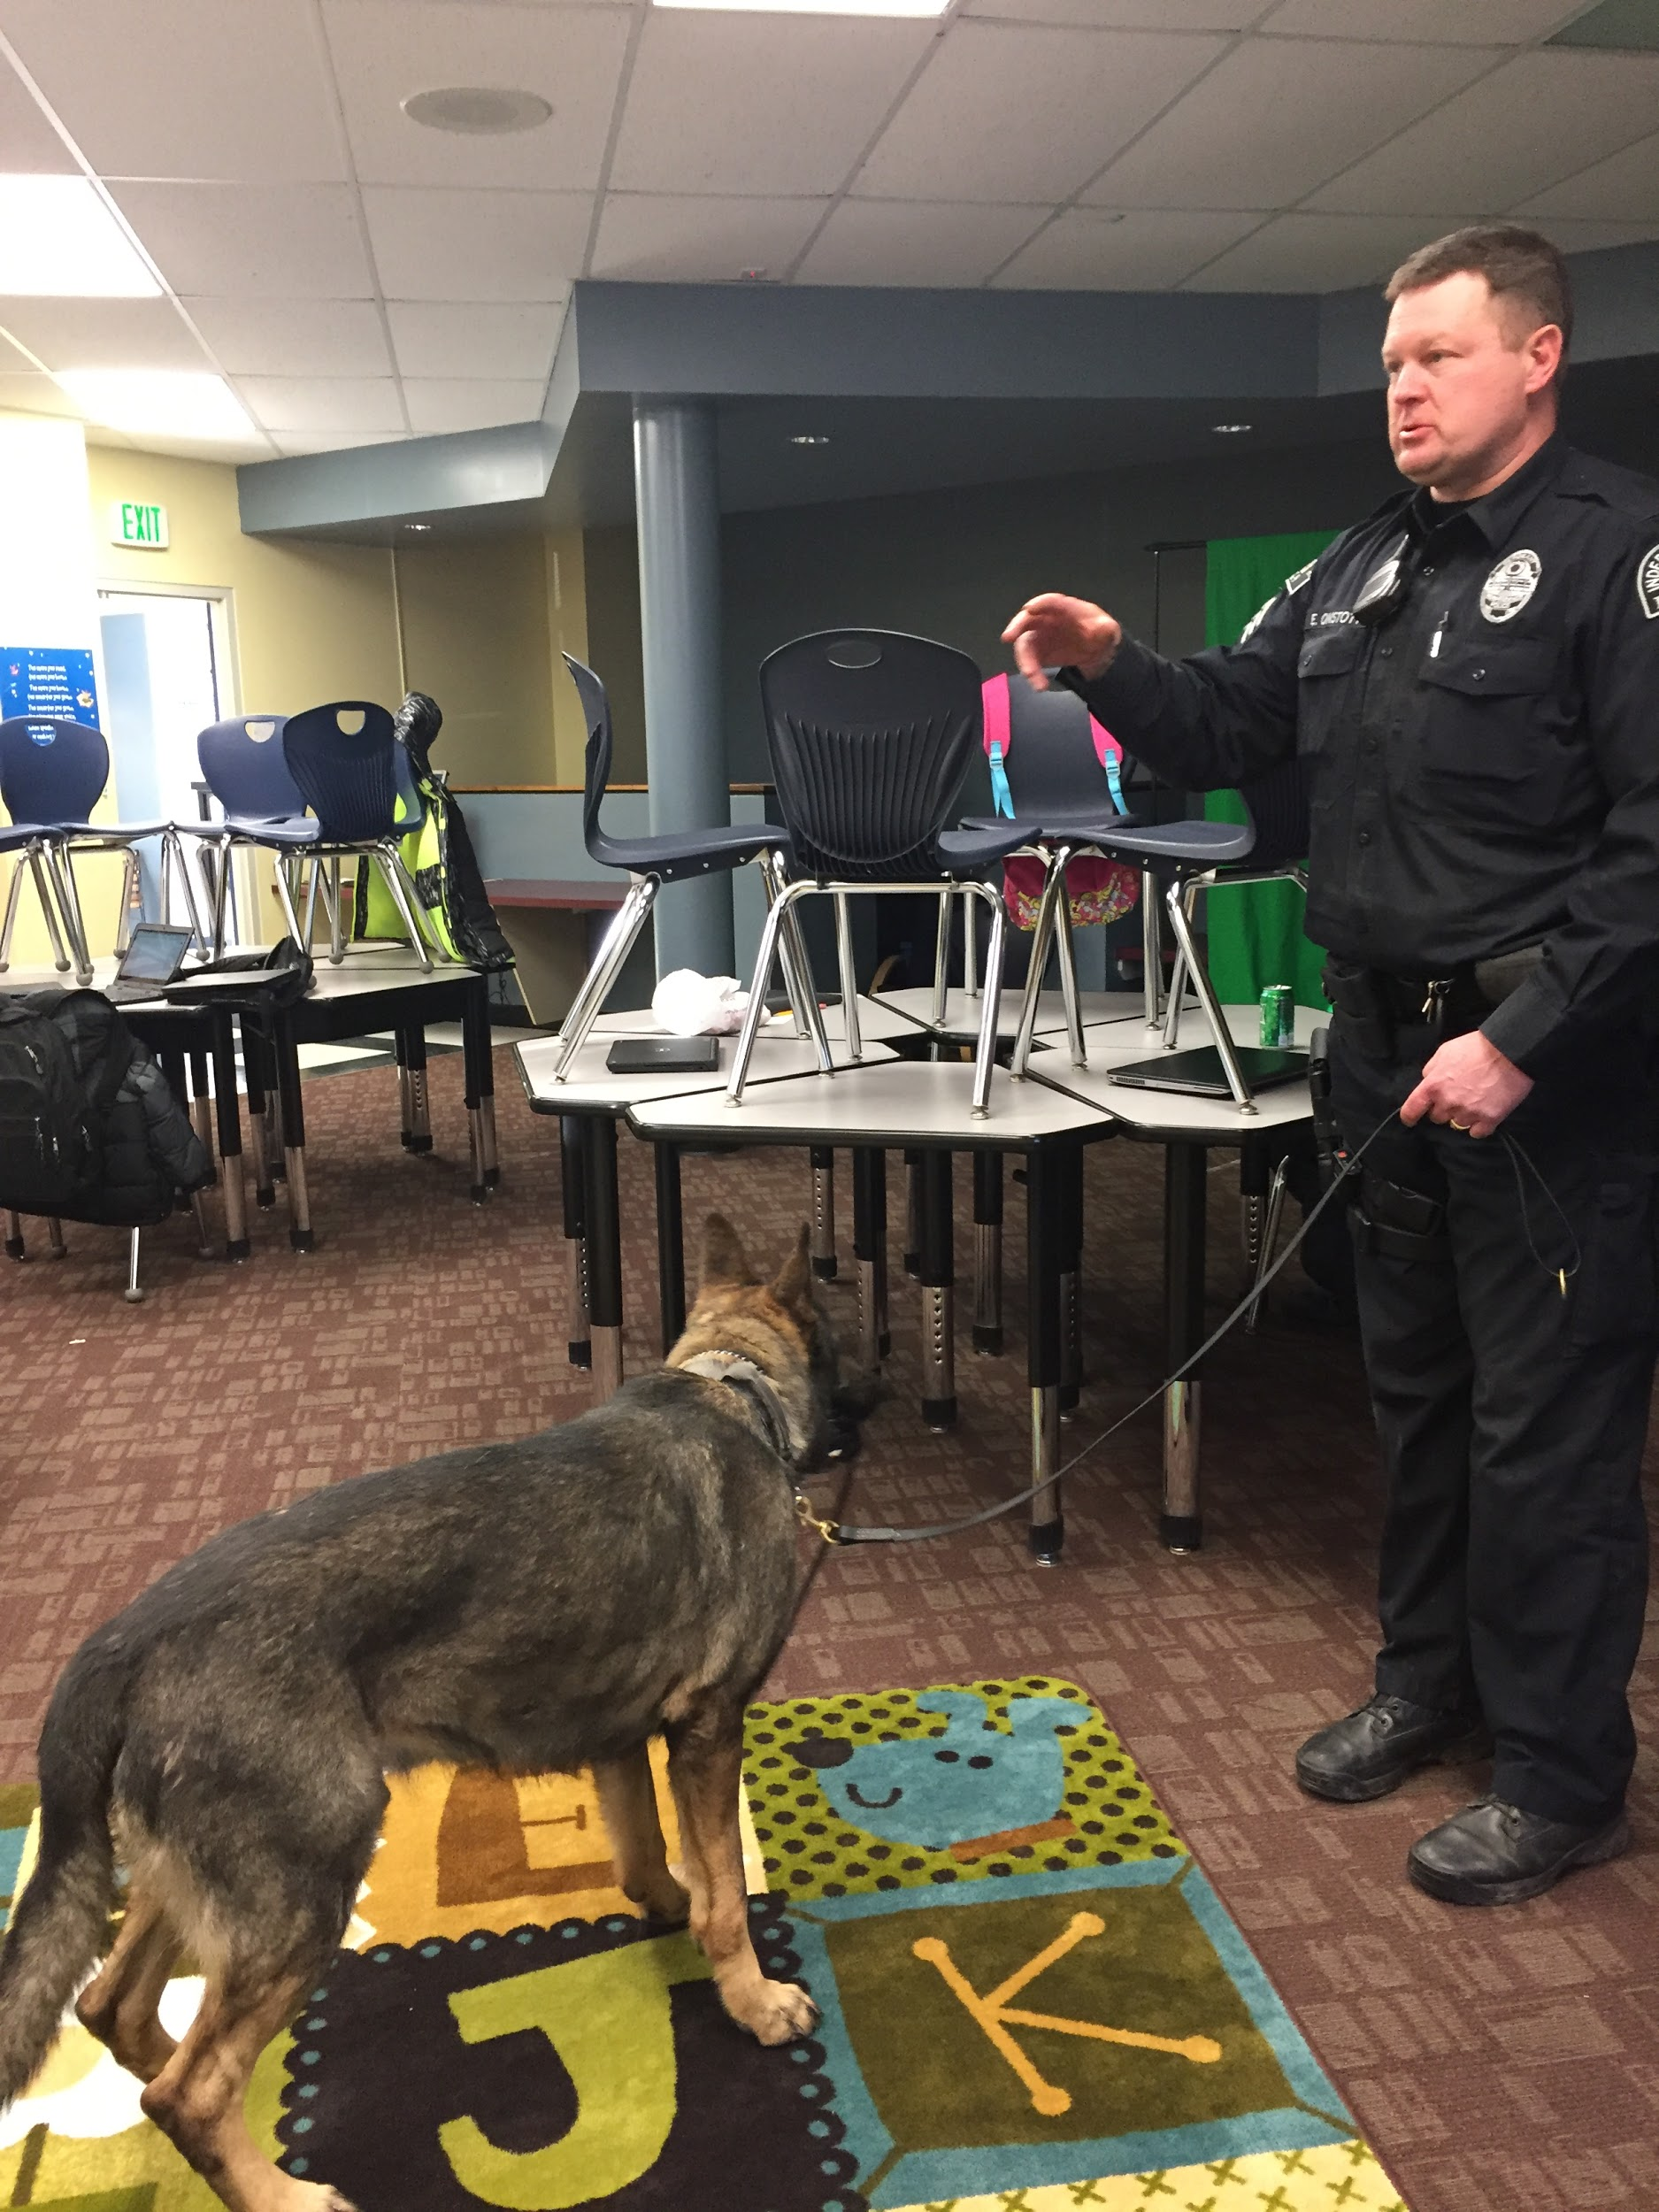
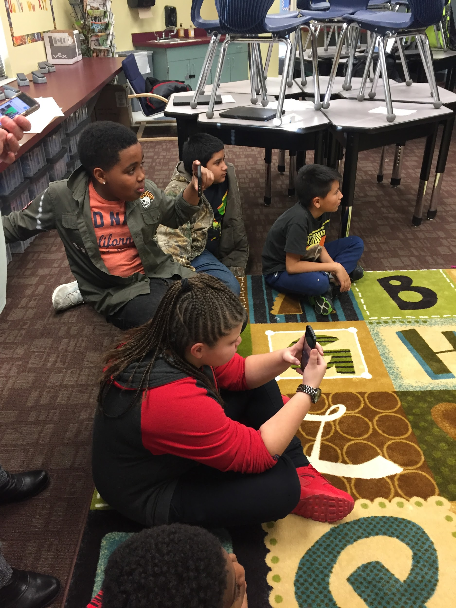

Slide 29
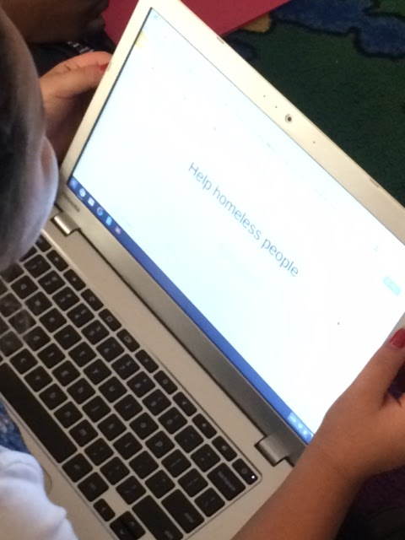
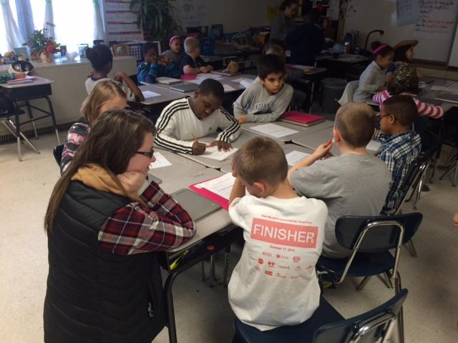

Slide 30
Randall Elementary - Genius Hour

Slide 31
Questions???

Slide 32
Resources
http://www.geniushour.com/ (Chris Kesler)
http://www.theinnovationteacher.com/ (Don Wettrick)
http://www.ajjuliani.com/

Slide 33
Thanks for attending today’s session!
Please feel free to contact me at:
bobby_mccutcheon@isdschools.org
@fight4mizzou and @RandallElementary

