Slide 1
Developing the Whole Child: A Unique Approach to Social and Emotional Learning
Pat Wallace
Wright City West Elementary Principal
Dawn Hickman
Wright City East Elementary Principal

Slide 2
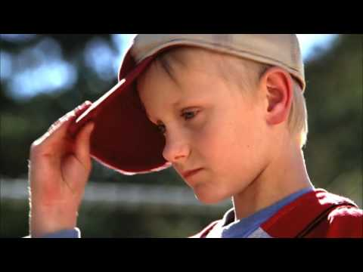
Notes:
The journey is hard, but the fight is worth it. Hang in there. Stay optimistic. The kids are worth it.

Slide 3
Sequence of a Behavior Event
Before
During
After
Notes:
Before-research, proactive positive relationships, lagging skills, understanding (scientist vs judge), infusing social emotional instructional lessons
During-

Slide 4
Social Emotional Learning and The K-5 Wright Way Plan
Trauma-Informed School
Infusion into Curriculum
Restorative Practices
R.U.L.E.R.
De-Escalation

Slide 5
Trauma-Informed School
Before
Identifying and Teaching Lagging Skills
Behavior Response Team (TLC Team)
Brain research
Building a positive adult to child relationships
Scientist vs. Judge
All emotions are okay how we express them is often the challenge for adults and children

Slide 6
Trauma
Anxiety
Lagging Skills
Mental Health
Before
Behaviors have hidden feelings and hidden request. We need to ask, “What is the child trying to communicate with this behavior?’
Notes:
Heroic teachers are facing this challenge with little to no training in mental health and behavioral principles. This leaves teachers to learn on the job and rely on their instincts, and it leaves the students with anxiety at risk for poor performance, diminished learning, and social or behavior problems in school.

Slide 7
Shift from:
“How do I get this child to change his/her behavior?”
To…
“What is driving this child’s behavior?”
“ What skills is this child missing?”
“What can I do at this very moment to improve my relationship with this student?”
Before
Ask the Right Questions...
Notes:
In order to figure this out we need to be asking the right questions...

Slide 8
Shift from:
“The child choose to act this way.”
To…
“How did I contribute to the behavior?
What could I have done differently?”
Before
Ask the Right Questions...
Notes:
In order to figure this out we need to be asking the right questions…
*Add the quote from Ross Greene

Slide 9
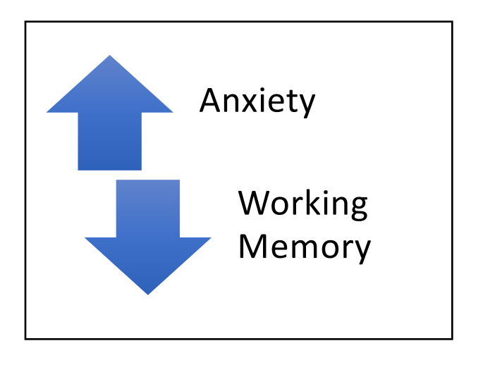
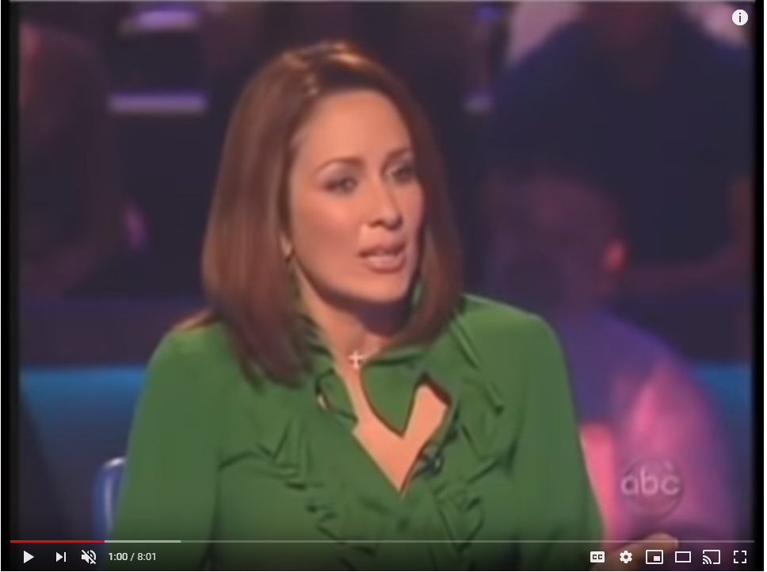
Before
https://www.youtube.com/watch?v=Rn_OhPKBjB0

Slide 10
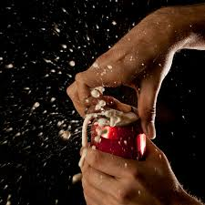
Anxiety
Before
Within the classroom, it is hard to identify the child with anxiety at times. It is like having two cans of soda and vigorously shaking one can without anyone seeing. Then ask someone to open one. The child with anxiety is the shaken soda and when triggered will explode.
We don’t always know what is going on inside the child with anxiety. However, we can chip away at negative or inaccurate thoughts.
Notes:
Turn and talk about what you know about anxiety/ ADHD
Bring shaken soda and some not shaken to hand out.

Slide 11
Solutions...
Before
INCENTIVES DO NOT TEACH SKILLS!
If we asked you to teach in French and offered you a $500 incentive per paycheck can you speak French the next day?
It won’t matter how much I offer you will still not be able to present in French without being taught the skills.
When creating a behavior plan you need to add strategy (s) to the intended goal behavior.

Slide 12
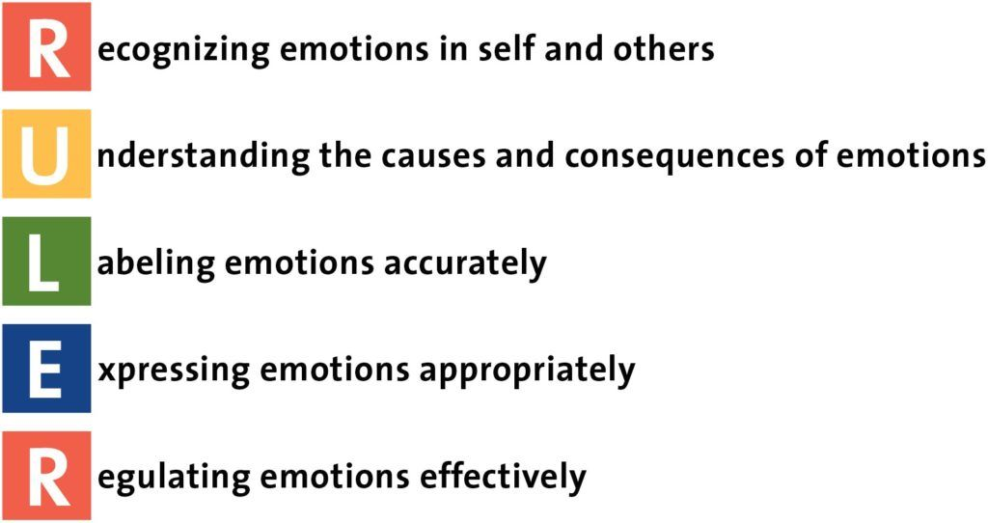
Direct Instruction of SEL Skills
Before

Slide 13
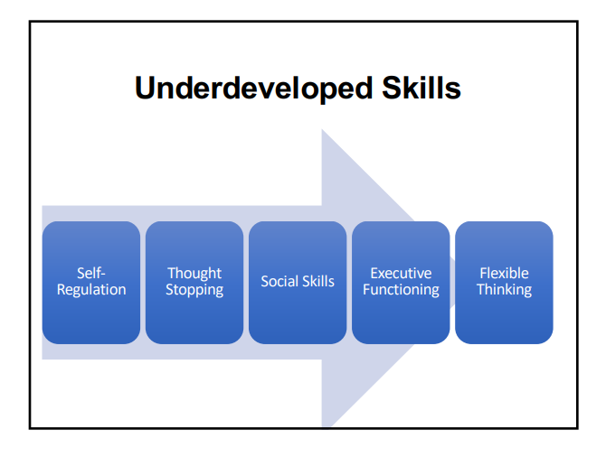
Before
Teach skills if you want to help with behavior!

Slide 14
We teach Reading...
We teach Math...
But we punish behavior?
Before

Slide 15
Four Parts of RULER
Before
The Charter
Mood Meter
Meta-Moment
Blue Print

Slide 16
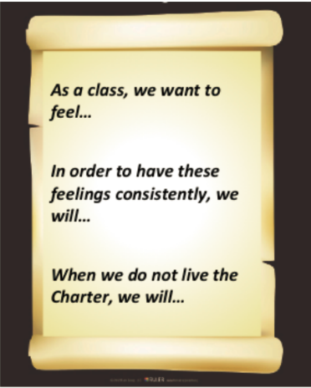
RULER- Charter
Before
Notes:
Quickly review the purpose of the Charter

Slide 17
Before

Slide 18
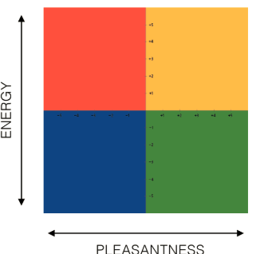
RULER- Mood Meter
RULER- Mood Meter
Before

Slide 19
Before

Slide 20
RULER-Meta-Moment
Before

Slide 21
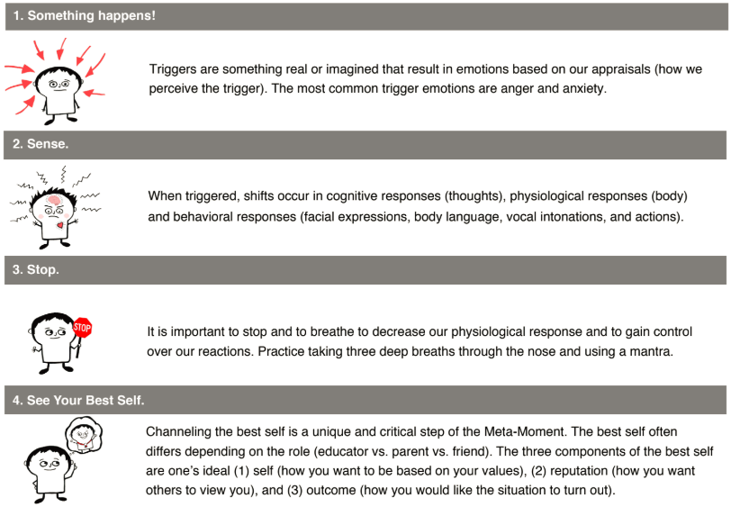
RULER- Meta-Moment
Before

Slide 22
RULER- Meta-Moment
Before
Notes:
Hand Out Meta-Moment Tip Sheet

Slide 23
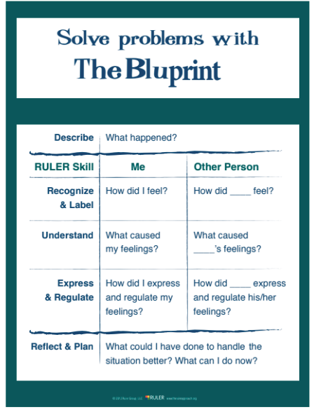
RULER- Blueprint
Before
Notes:
Hand Out Blueprint Tip Sheet
Restorative Practices Connection

Slide 24
Before

Slide 25
Breakfast in the Classrooms and Morning Meetings
Before

Slide 26
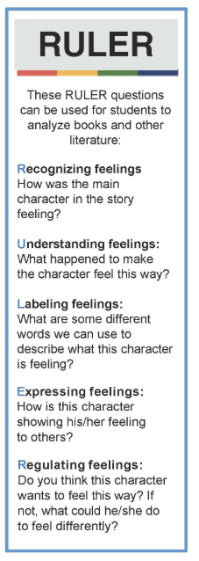
Infusion into Curriculum
Before
Aligning ELA with the Mood Meter: http://rulercommunity.yale.edu/wp-content/uploads/2016/09/Aligning-ELA-with-the-Mood-Meter_Handout.pdf
RULER Student Bookmarks: http://rulercommunity.yale.edu/ruler-bookmark-k-8/
Book List for Meta-Moment: http://rulercommunity.yale.edu/book-list-meta-moment-practice/
Notes:
Add ideas of what teachers have done to infuse social emotional lessons into everyday lessons

Slide 27
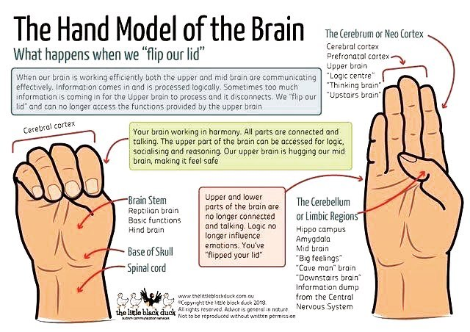
De-Escalation
During
“When the demands being placed on a student exceed his capacity to respond adaptively is when you see challenging behavior.” - Dr. Ross Greene
“Kids do well if they can.” - Dr. Ross Greene
Notes:
Help for Billy page 21- graphics, brain images-flipped brain,

Slide 28
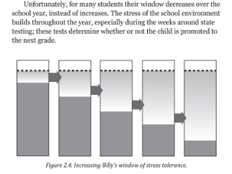
Teacher and Student Window of Stress Tolerance
During
“It’s a frustrating situation for sure, but my friend, you have far more power and influence than you may think. And I don’t mean in the “savior” sense. You’re not Michelle Pfeiffer, and this isn’t Dangerous Minds. We’re not talking about saving students, nor is it your responsibility to do so.
This is about having a restorative mindset versus a punitive mindset, and about what happens when we choose as a school community to approach behavior problems through a lens that is focused on long-term solutions which restore a child to wholeness rather than punishing or criminalizing kids for their behavioral choices.” -Angela Watson Podcast

Slide 29
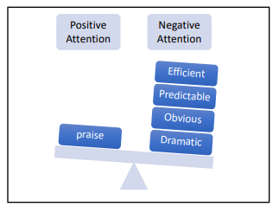
Solutions...
During
PREDICTABILITY…
Students with anxiety thrive in predictable environments. Negative attention is more predictable.
We are more unpredictable when a child is doing the right thing!
Students with anxiety need that predictable cause and effect.

Slide 30
Solutions...
During
PREDICTABILITY…
Provide Predictable Positive Attention
Ideas: Start by checking in with the child. Get them started and let them know you will be back in ___minutes. Set their timer and come back and check on the child. Increase the time as the stamina increases.
- now anxious thoughts are paired with a comforting thought, the teacher will be right back at a predictable time that can be seen.
Similar to being in an emergency room if you know when you will be seen it instantly calms your anxiety. When you don’t know when you will be seen, as time goes on you become more anxious.

Slide 31
Solutions...
During
IGNORING IS NOT THE ANSWER!
Ignoring lower level behavior will increase the behavior and create an increased skill leave to get attention in a negative way.
Ask: What type of attention is the child looking for? (All children need and want attention, but ASK yourself, what attention is the behavior communicating?)

Slide 32
Solutions...
During
BREAKS
Purpose of breaks are that students are calmer and more regulated after them
What percentage of breaks lead students to be calmer after?
Negative thoughts fester during traditional breaks (water, take a walk= thoughts still ruminate)
Provide thought/cognitive distraction breaks (listening center, Where’s Waldo or I Spy, Go Noodle!)
Your brain is like a remote control, so breaks need to change the channel

Slide 33
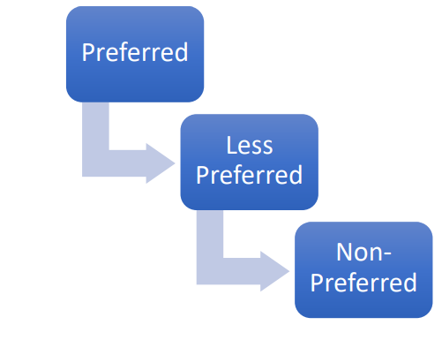
Solutions-Transitions
During

Slide 34
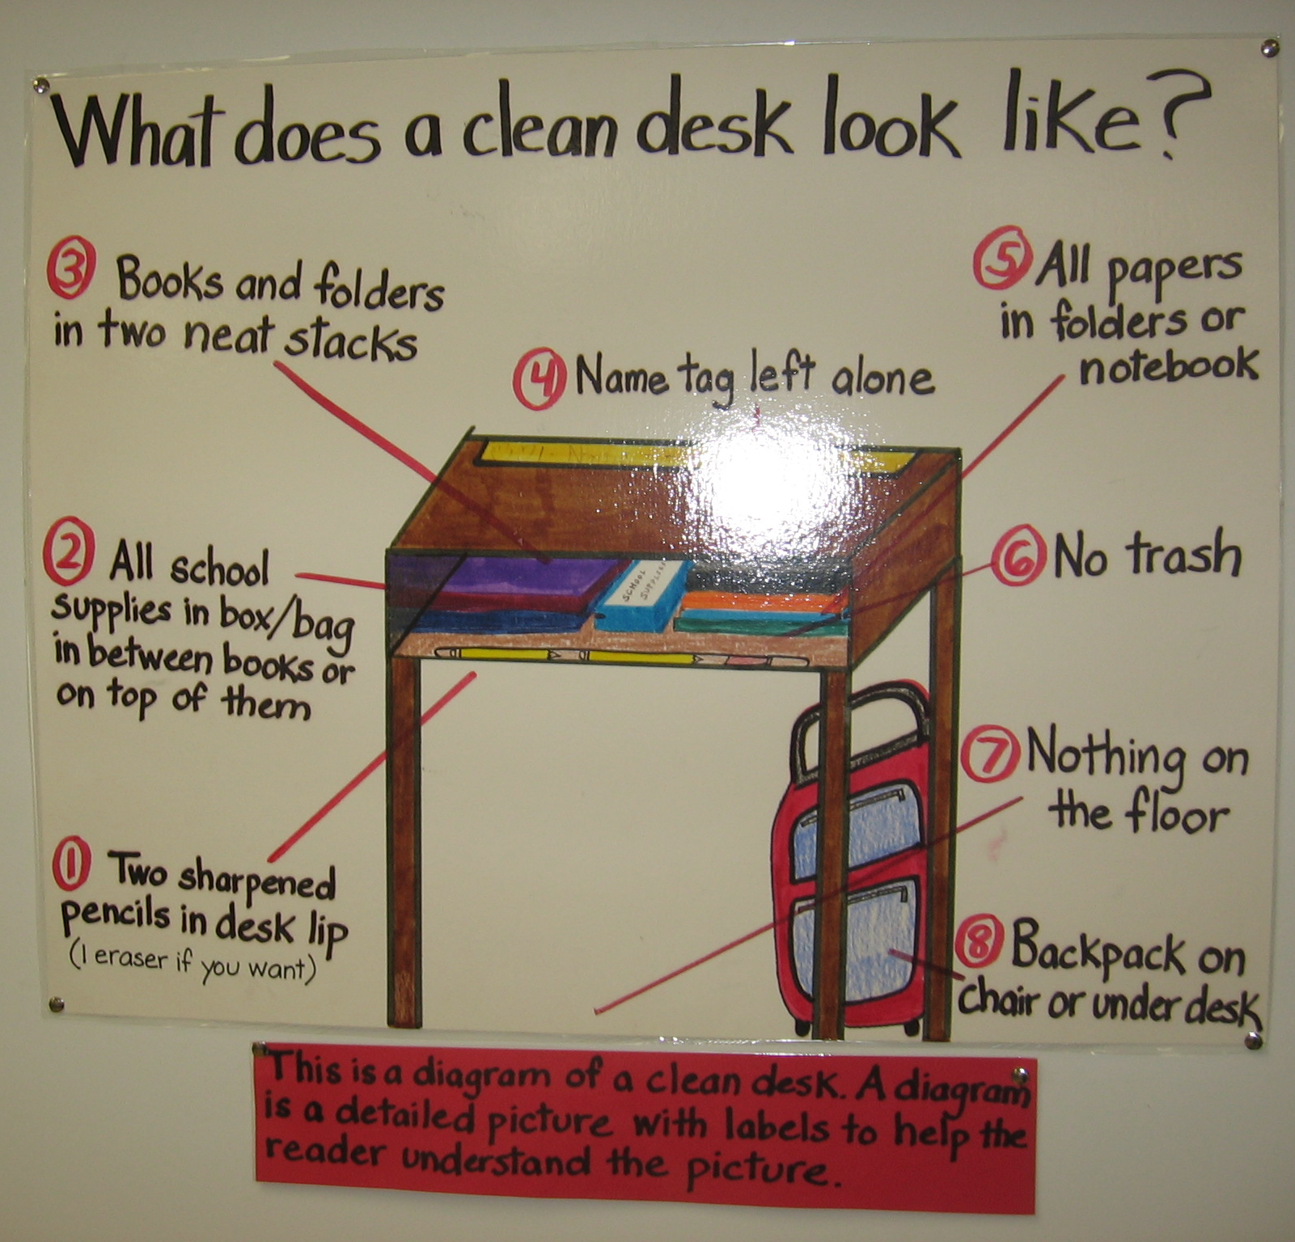
Solutions
During
TRANSITION IDEAS
Quick review movies after recess “just happened to be on”
Flocabulary
Class Dojo Core Value Videos
Math review videos
Brain Pop
Just saying “five more minutes” is not enough since kids make bad decisions in that time
Ask “what’s your five minute plan?”
Mental transitions before physical transitions
Provide pictures and visuals and say “match the picture” versus telling them with descriptions. Removes language barrier.
Replace “STOP” with “PAUSE”
Reduces anxiety
Notes:
Students can make a poor plan when asked to transition: such as reading, child told five minutes will plan to read 5 more pages and stop. A child with anxiety will make the plan to finish the chapter book. Reduce the anxiety by saying pause and quietly meet with the child to create a plan on where to pause and give the child a “PAUSE post- it” to mark the place to pause and get ready to transition.

Slide 35
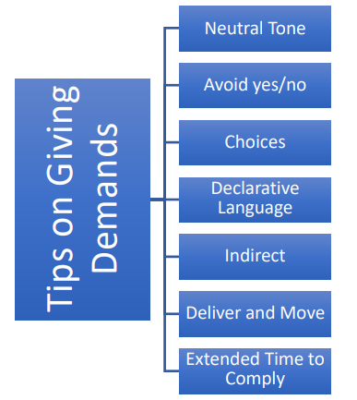
Solutions...
During

Slide 36
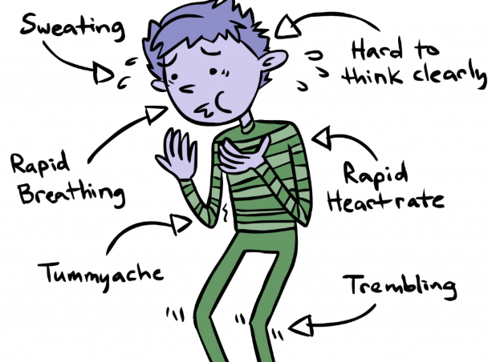
Solutions...
During
OTHERS
Strategy to reduce test anxiety
Students can skip any two problems on the quiz or assessment
Writing
Writing involves a lot of thought and can lead to anxiety
Scaffold the parts of the writing process for the students

Slide 37
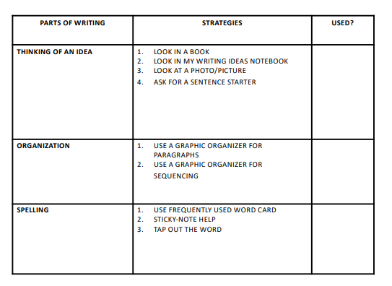
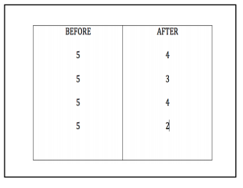
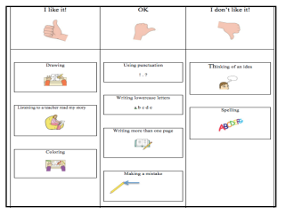
During

Slide 38
Most importantly of all…
Know your students!
During
The Power of Being Seen
Greet Students at the Door:
Welcoming Students with a Smile
“Remember that a person’s name is to that person the sweetest and most important sound in any language.” - Dale Carnegie
Notes:
Article: https://www.edutopia.org/article/power-being-seen

Slide 39
Restorative Practices
After
K-1 Approach:
Push-In Teacher
Including students in conversations. Modeling how to restore a wrong with a another person.
2-5 Approach:
Re-framing ISS with the Restorative Action Plan

Slide 40
Results
After
Wright City East Elementary K-1
Wright City West Elementary 2-5

Slide 41
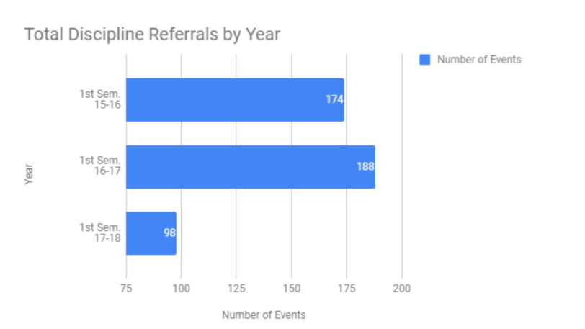
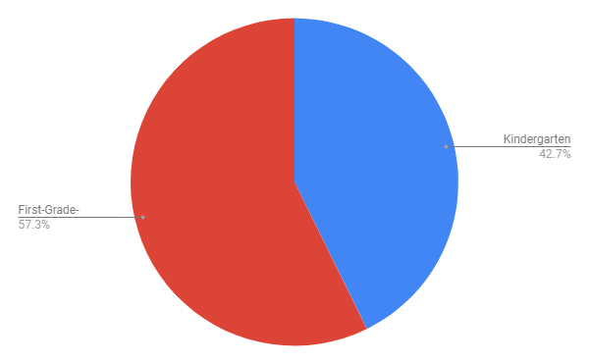
Discipline Data
Discipline Data for First Semester with Three Year Comparison
The first semester of the 2018-2019 school year had 96 behavior office referral events. This was slightly down from last year’s first-semester office referrals as seen on the chart below.

Slide 42
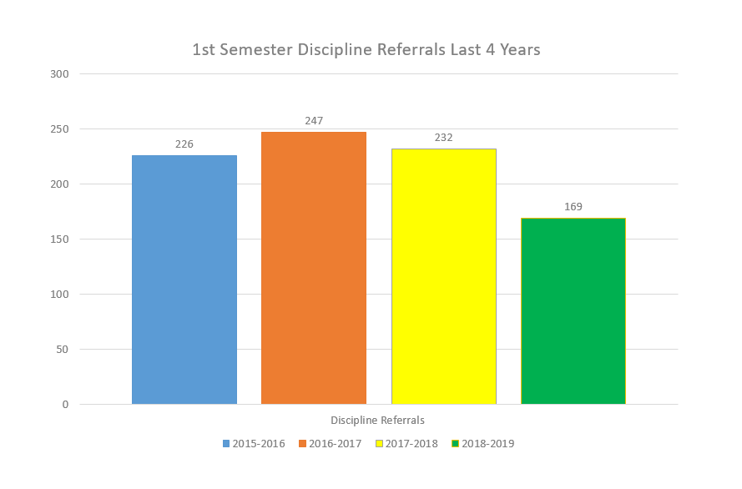
Discipline Data

Slide 43
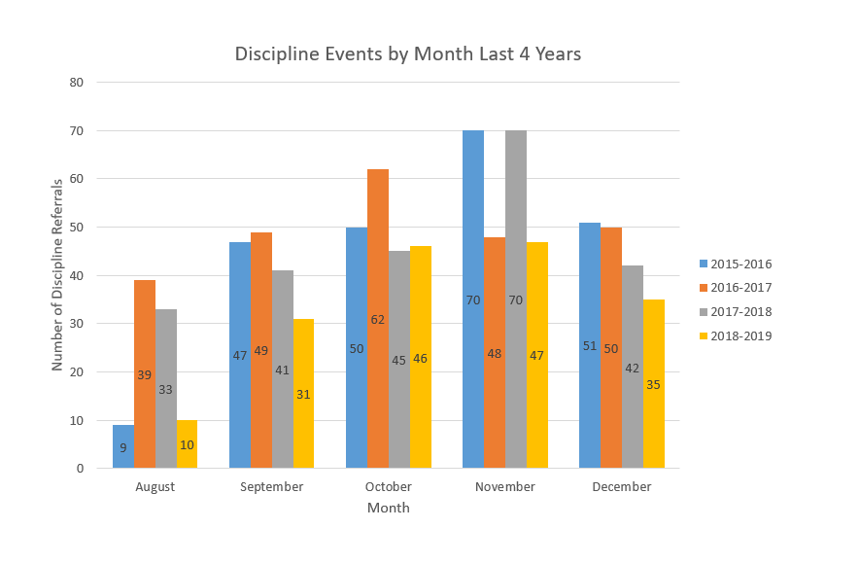
Discipline Data

Slide 44
Discipline Data

Slide 45
K-5 Social-Emotional Vision
After
The Wright Way Plan

Slide 46
More Resources...
Links:
Lives in the Balance
Jessica Minahan
YALE-RULER Social Emotional Intelligence
Apps for Self-Regulation
Calm
Headspace
Moodnotes (not free)
Moodpath
Pacifica
SuperBetter (game to teach resilience)
7 Cups
Anxiety Relief Hypnosis
Happify
Talkspace

