Slide 1
What Does Teaching Dyslexia Look Like In Your School?
Presented By:
Jewel Farwell– Title 1 Teacher
Cathy Nunley – Title 1 Teacher
Miranda Cupit- Title 1 Teacher

Slide 2
Contact Us
Cathy Nunley: cnunley@cassville.k12.mo.us
Jewel Farwell: jfarwell@cassville.k12.mo.us
Miranda Cupit: mcupit@cassville.k12.mo.us
Phone: (417) 847-4010

Slide 3
Demographics
Located in the southwest corner of the state (20 minutes from the AR line and one hour from OK or KS
Rural school that comprises approximately 350 square miles, with 19 bus routes
Approximately 1,800 students PK-12
K-5 has 6 base rooms per grade level and 2 classes of Kinder Academy
PK-5 is a Title 1 school
Free & Reduced rate is 61%
Predominately white with Hispanic as our second highest ethnicity
10% IEP and ELL is about 4%

Slide 4
What is Dyslexia?
Dyslexia is a language-based learning disability. Dyslexia refers to a cluster of symptoms, which result in people having difficulties with specific language skills, particularly reading. Students with dyslexia usually experience difficulties with other language skills such as spelling, writing, and pronouncing words. Dyslexia affects individuals throughout their lives; however, its impact can change at different stages in a person's life. It is referred to as a learning disability because dyslexia can make it very difficult for a student to succeed academically in the typical instructional environment, and in its more severe forms, will qualify a student for special education, special accommodations, or extra support services. Taken from Reading Rockets

Slide 5
1-800-931-4371

Slide 6
ERC GLW MKC CXN
CMC JAF CSK YSR
MKKW HGLY NBDS TPLK

Slide 7
NBC ABC CNN NCAA
ESPN MLB PBS NFL
HBO KTTS ACL CMT

Slide 8
How is Dyslexia Treated?
Dyslexia is a lifelong condition. With proper help, many people with dyslexia can learn to read and write well. Early identification and treatment is the key to helping individuals with dyslexia achieve in school and in life. Most people with dyslexia need help from a teacher, tutor, or therapist specially trained in using a multi-sensory, structured language approach. It is important for these individuals to be taught by a systematic and explicit method that involves several senses (hearing, seeing, touching) at the same time. Many individuals with dyslexia need one-on-one help so that they can move forward at their own pace. In addition, students with dyslexia often need a great deal of structured practice and immediate, corrective feedback to develop automatic word recognition skills. For students with dyslexia, it is helpful if their outside academic therapists work closely with classroom teachers.
Retrieved from www.interdys.org

Slide 9
Legislation
167.950. (1) By December 31, 2017, the department of elementary and secondary education shall develop guidelines for the appropriate screening of students for dyslexia and related disorders and the necessary classroom support for students with dyslexia and related disorders. Such guidelines shall be consistent with the findings and recommendations of the task force created under section 633.420. (2) In the 2018-19 school year and subsequent years, each public school, including each charter school, shall conduct dyslexia screenings for students in the appropriate year consistent with the findings and recommendations of the task force created under section 633.420. (3) In the 2018-19 school year and subsequent years, the school board of each district and the governing board of each charter school shall provide reasonable classroom support consistent with the findings and recommendations of the task force created under section 633.420. In the 2018-19 school year and subsequent years, the practicing teacher assistance programs established under section 168.400 shall include two hours of in-service training provided by each local school district for all practicing teachers in such district regarding dyslexia and related disorders. Each charter school shall also offer all of its teachers two hours of training on dyslexia and related disorders. HCS HB 2379 Schools may seek assistance from the department of elementary and secondary education in developing and providing such training. Completion of such training shall count as two contact hours of professional development.

Slide 10
Legislation
633.420. For the purposes of this section, the term "dyslexia" means a disorder that is neurological in origin, characterized by difficulties with accurate and fluent word recognition, and poor spelling and decoding abilities that typically result from a deficit in the phonological component of language, often unexpected in relation to other cognitive abilities and the provision of effective classroom instruction, and of which secondary consequences may include problems in reading comprehension and reduced reading experience that can impede growth of vocabulary and background knowledge. Nothing in this section shall prohibit a district from assessing students for dyslexia and offering students specialized reading instruction if a determination is made that a student suffers from dyslexia. Nothing in this definition shall require a student with dyslexia to obtain an individualized education program (IEP) unless the student has otherwise met the federal conditions necessary.

Slide 11
Legislation In A Nutshell
HB 2379 and SB 638
Required DESE to develop guidelines for screening of students with dyslexia
Required DESE to develop the necessary classroom support for such students
Required practicing teachers to receive two hours in-service training regarding dyslexia and related disorders
SB 949, HB464, HB33, SB249
Currently in the legislation
Requires reading success plans for students K-3 reading below grade level, structured literacy, and intensive intervention for those reading below 2nd grade at the end of 2nd grade.

Slide 12
Creating the Dyslexia Task Force
Representatives from each grade level K-3
Representatives from Title 1 departments K-3
Representatives from Speech & Language departments
Building Principals, Primary & Intermediate
Representatives from Central Office, Directors of Learning
Meet periodically beginning Spring 2018 through Spring 2019
Identified needs
Developed Dyslexia Plan for the district
Developed communication piece for parents

Slide 13
Dyslexia Plan

Slide 14
Screeners Our School Uses
iReady
Rapid Automatized Naming Test (RAN)
Words Their Way
Writing Sample
Dibels
Developmental Reading Assessment (DRA)
**Looking at Lexercise

Slide 15
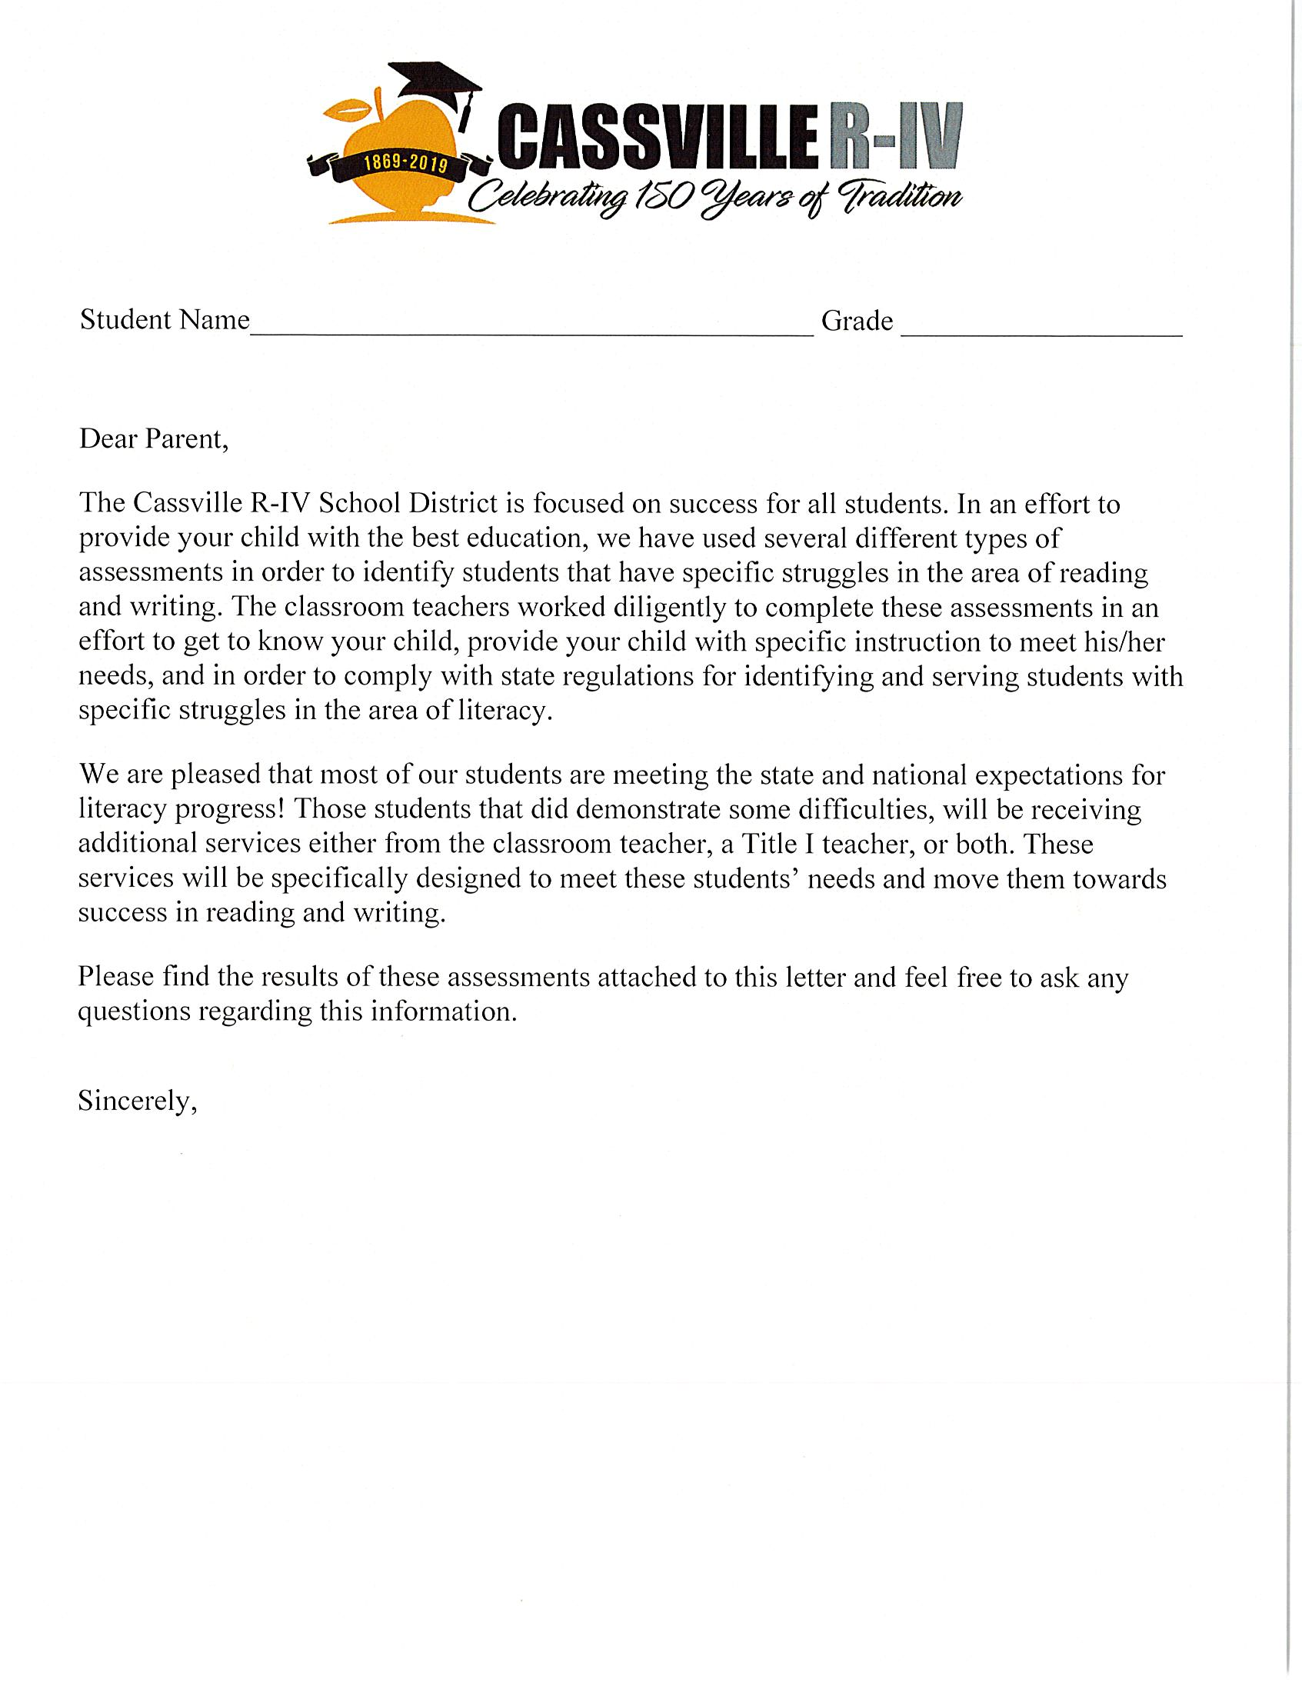
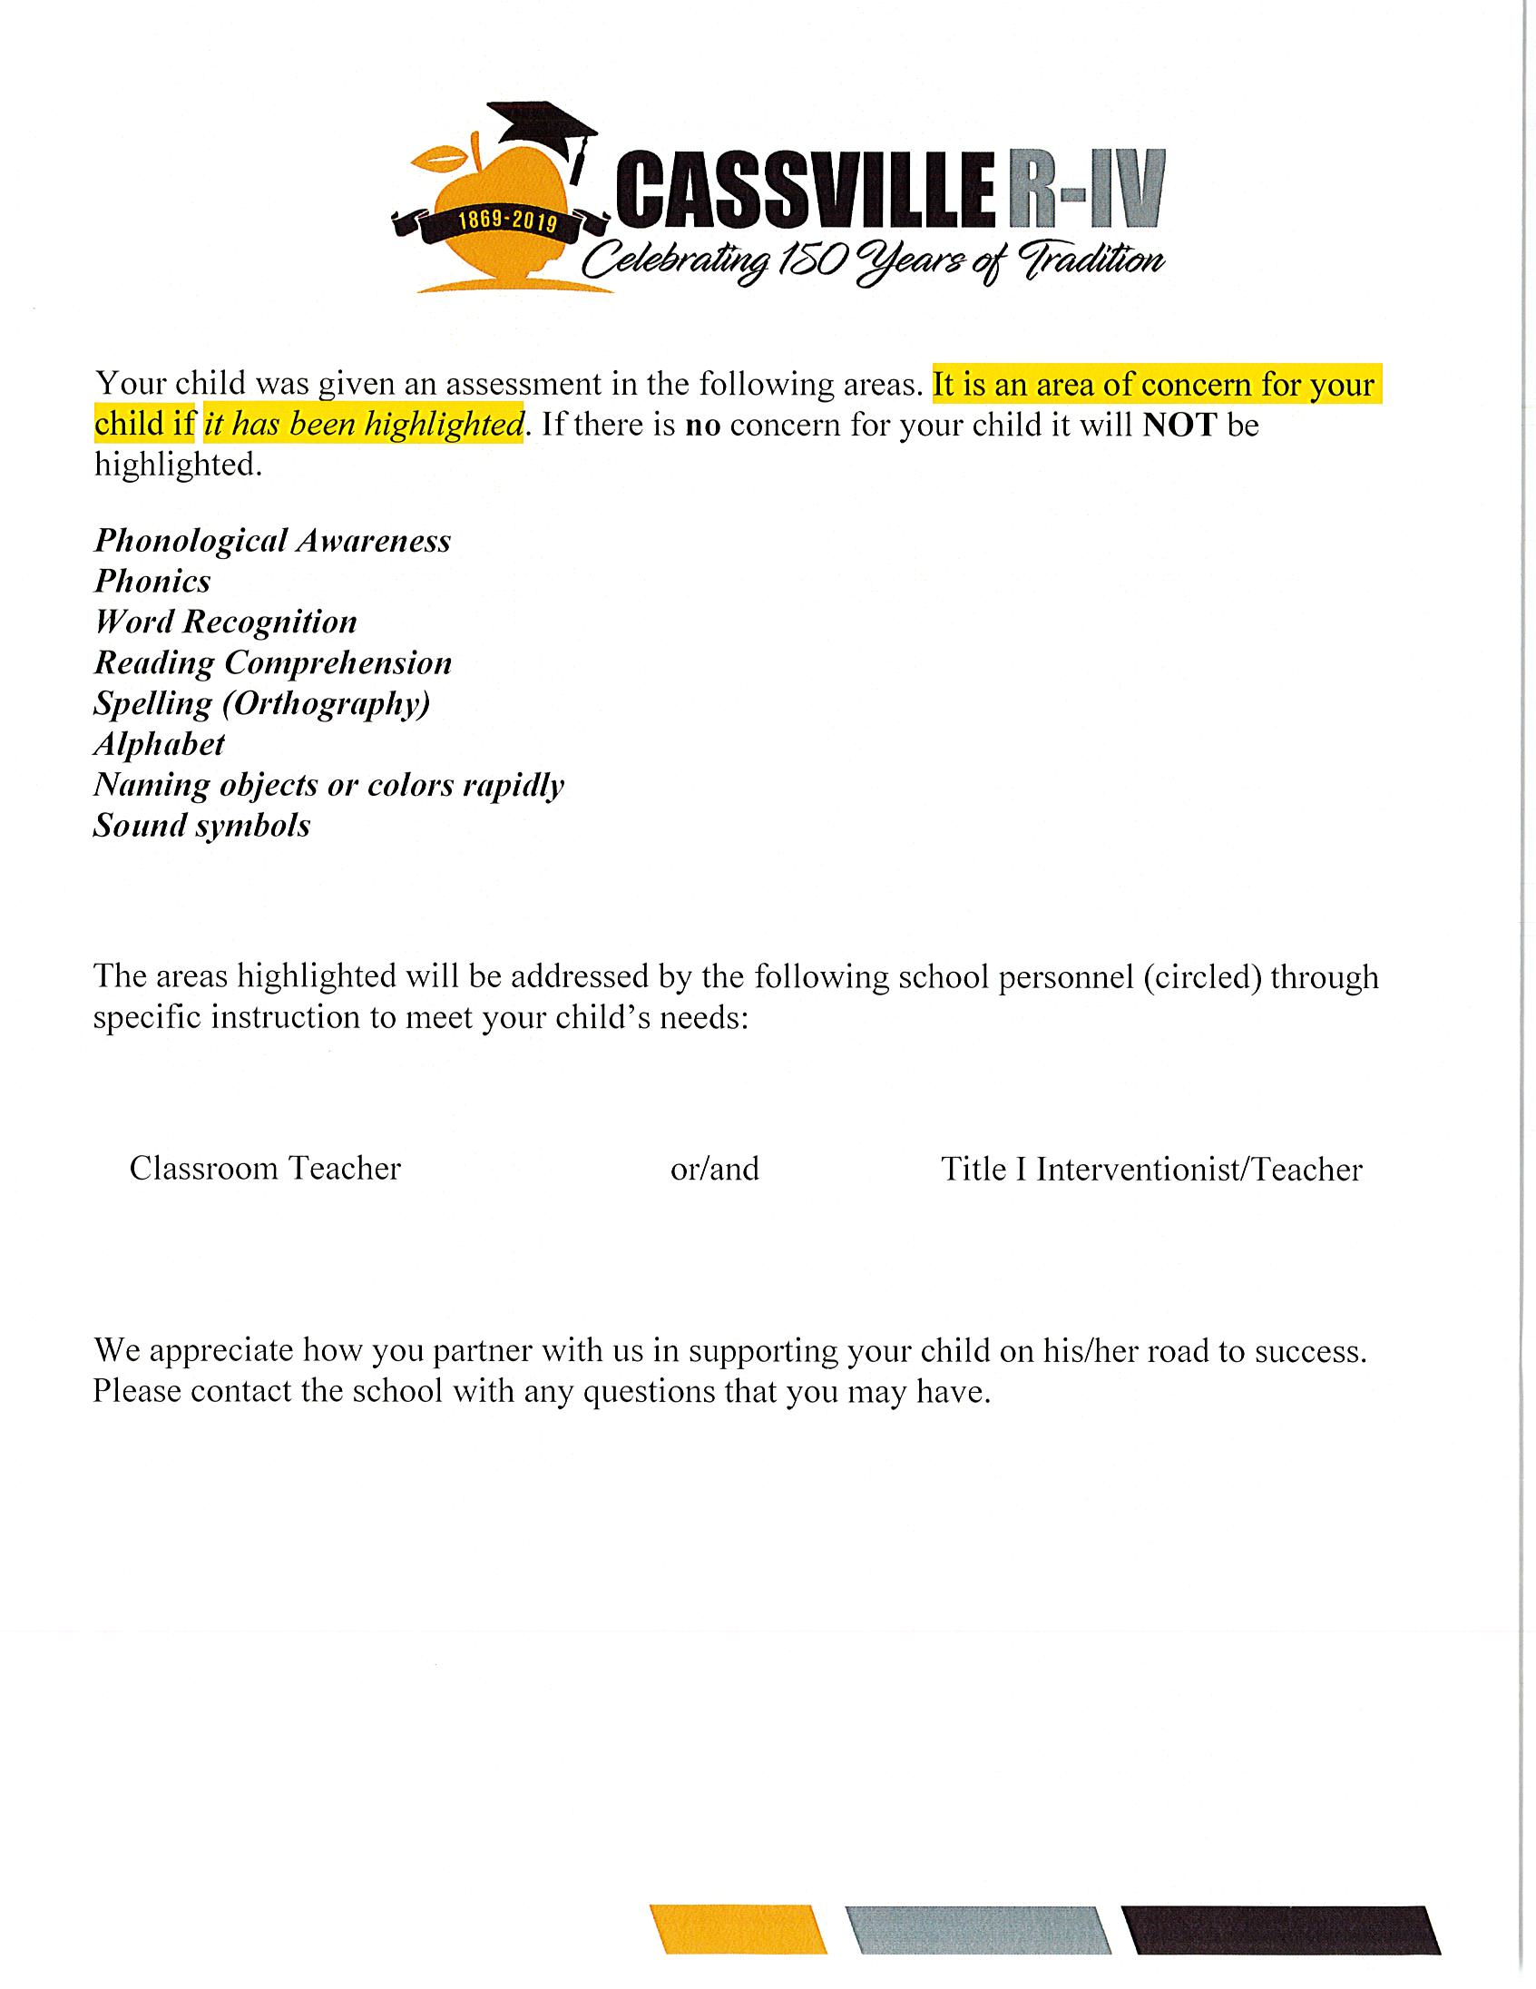

Slide 16
Diagnostics Used In Title
Writing Sample
Sight Words
ABC Principle
Phonics Assessment (Includes nonsense words)
Prefixes/Suffixes Identification and Meaning
Phonemic Awareness & Phonological Assessment

Slide 17
Balanced Literacy vs Structured Literacy
Base room teachers use balanced literacy
Title teachers use more of a structured literacy approach

Slide 18
What is Structured Literacy?
Structured literacy is evidence based reading instruction that addresses phonology, sound symbol association, syllable instruction, morphology, syntax, and semantics. Structured literacy is taught through systematic, cumulative, explicit, and diagnostic methods.
Evidence based reading instruction, any research validated program that has successful evidence to demonstrate adequate gains in reading achievement where such evidence is objective data that any evaluator would identify and interpret similarly, valid data on the tasks children need to accomplish to be successful readers, reliable data that will remain essentially unchanged if collected on a different day or by a different person, systematic data that is collect according to a rigorous design of either observation or experimentation, and referred data that has been approved for publication by a panel of independent reviewers.

Slide 19
Skills We Teach
Alphabet and quick retrieval
Letter Sounds
Phonemic awareness
Phonological awareness
Decoding
Spelling
Sight words
Fluency
Comprehension
Prefixes/Suffixes

Slide 20
Strategies Used In Our Classrooms
Repetition of letters and sounds
Syllabication Folders
Creating Sentences & Sequencing
Multisensory Activities
Lexical Matrix
Partially completed graphic organizers

Slide 21
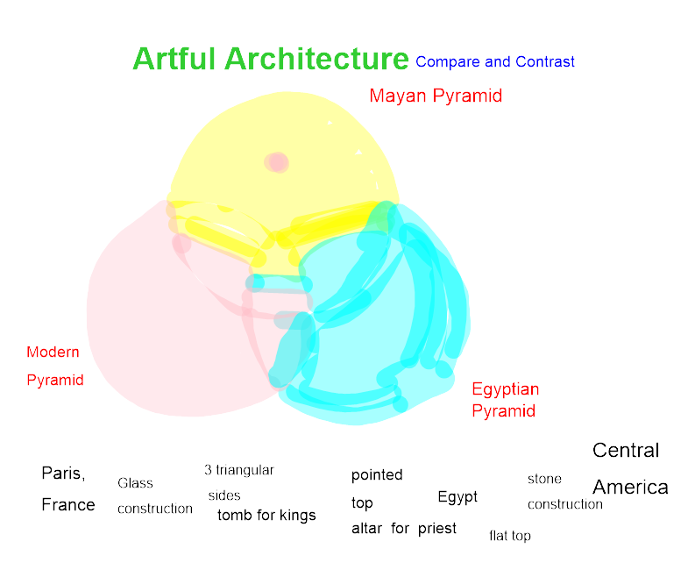
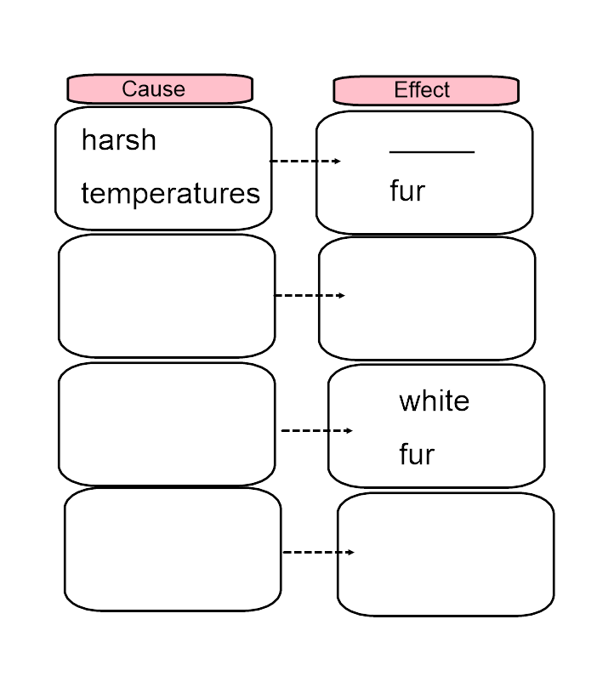
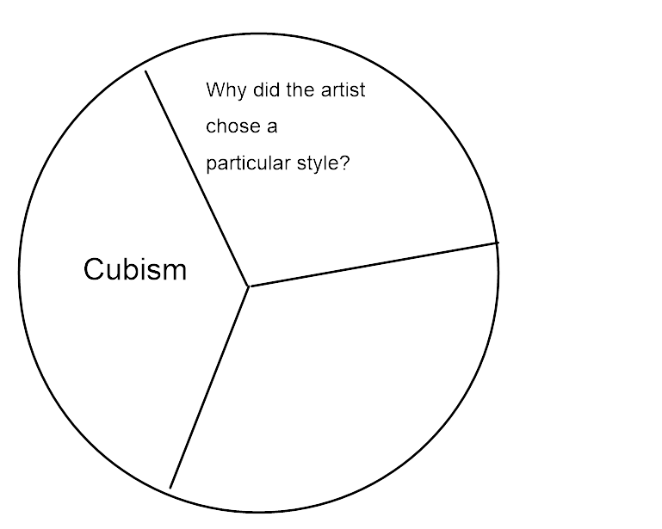

Slide 22
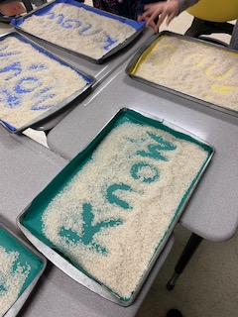
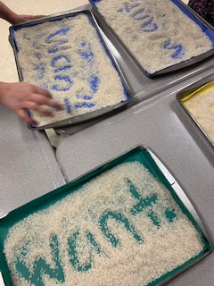
Writing sight words in rice

Slide 23
Time To Share
What does your district use to screen for dyslexia?
How did you communicate the results with your parents?
What great resources have you found?
What strategies have you found to be successful in your classroom or district?
Do you have a phonics curriculum?

Slide 24
Resources
Resources:
Florida Center for Reading Research http://fcrr.org
National Center for Improving Literacy http://improvingliteracy.org
Intervention Central https://www.interventioncentral.org/
RtI Action Network http://www.rtinetwork.org/
National Center for Intensive Intervention http://intensiveintervention.org
Resources for families:
International Dyslexia Association http://www.eida.org
National Center for Learning Disabilities http://www.ncld.org
For Families; http://www.understood.org
Yale Center for Dyslexia and Creativity http://www.dyslexia.yale.edu
Reading Rockets http://www.readingrockets.org
Decoding Dyslexia-Missouri http://decodingdyslexia-mo.org/

