Slide 1
Got Foundation Formula for Preschool Children?
Janet Rinehart, Director of Missouri Learning Communities
Lana Brooks, Director of Early Learning, DESE
March 2019

Slide 2
What is your purpose for attending this presentation?

Slide 3
Early Learning Funding Streams
Child Care Subsidy Program
Early Childhood Special Education
Foundation Formula
Local Funding
Missouri Preschool Program
Parent Fee/Scholarship
School Lunch Program/Child and Adult Care Food Program
Title I

Slide 4
Sources for Indicators of Quality
Early Learning Program Standards (Missouri)
Quality Assurance Report (Missouri)
Desired Results Developmental Profile (National)
Early Childhood Environmental Rating Scale (National)
National Institute for Early Education Research (National)

Slide 5
All Students Enter Kindergarten Prepared to be Successful
How Do We Get There?
Understanding Child Development
Quality Programing

Slide 6
Child Development Made Easy
Children think and process information significantly different than an adult.
Children move through their development at their own pace.
Notes:
Janet starts

Slide 7
Stages of Development
Sensorimotor Stage - Birth-2 years
Preoperational Stage - 2 years-7 years
Concrete Operational Stage - 7-11 years
Formal Operational Stage - 12 and up

Slide 8
Sensorimotor Stage

Slide 9
Preoperational Stage
Language Emerging
Egocentric
Learns through pretend play, but struggles with logic

Slide 10
Concrete Operational Stage
Begins to think logically
Understand conservation
Thinking more organized
Develops friends
Struggles with abstract thinking
The job of wiring is almost completed

Slide 11
Formal Operational Stage
Thinks abstractly
Thinks morally, philosophically, ethically, socially, politically
Deductive thinking
Can find multiple solutions

Slide 12
Active Process
“We are not passive recipients of knowledge, but actively involved in investigating and experimenting as we build understanding of how our world works….”
Jean Piaget

Slide 13
What Does All This Mean?
We can’t change development, BUT we can change the quality of the experiences that children receive.
The quality of the child’s experiences determines how well and how thoroughly the wiring in the brain is complete.

Slide 14
What Are the Components of Quality?
Missouri Early Learning Goals – A tool to guide teacher practice
Desired Results Developmental Profile - An assessment the looks at child outcomes
Early Childhood Environmental Rating Scale - A tool used nationally and internationally

Slide 15
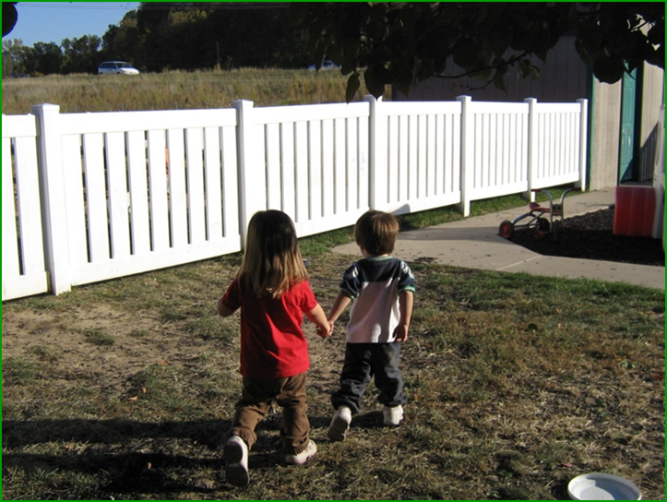
Quality is Children Participating in PLAY

Slide 16
“Guided play (purposeful) requires a skilled teacher to analyze and steer students through their play to spontaneous learning.”
Kate Stringer, Senior Writer for The 74.

Slide 18
Six Overarching Subscales on the ECERS-3
Space and Furnishings
Personal Care Routines
Language and Literacy
Learning Activities
Interaction
Program Structure

Slide 19
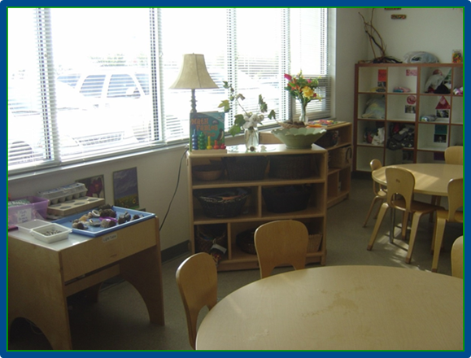
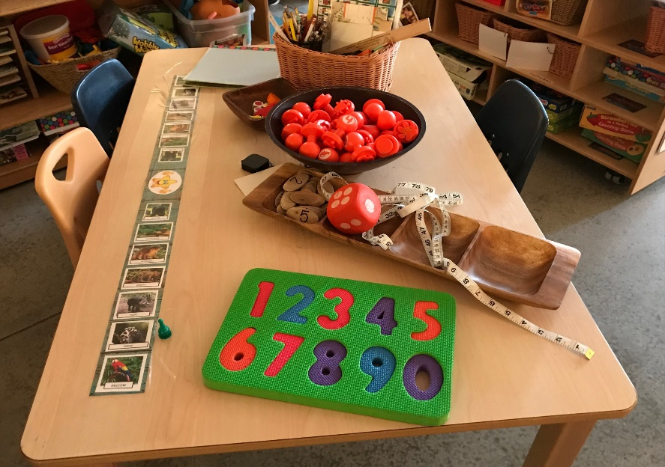
Space influences the number and types of activities children can engage in at the same time.
Insufficient space can lead to conflicts due to crowding.

Slide 20
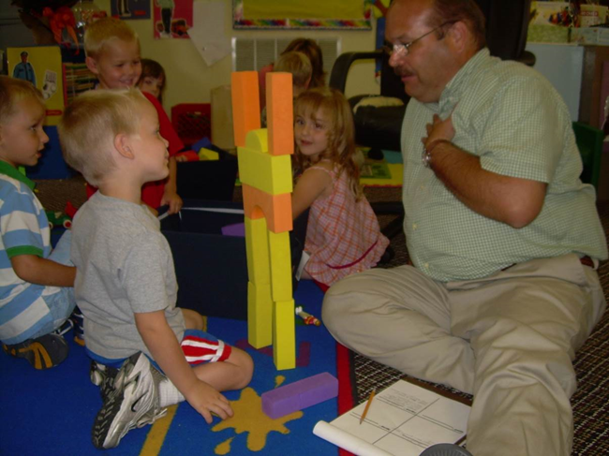
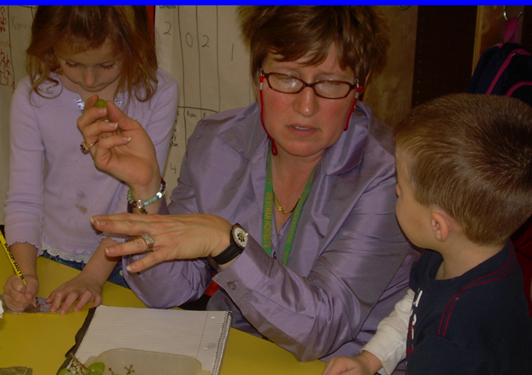
The starkest contrast between poor and affluent children is experience in hearing and using language.

Slide 21
“Preschool children-and in particular the children of poverty-do not need lessons in decoding: they need exposure to rich discourse….” (Tabors, 1997)

Slide 22
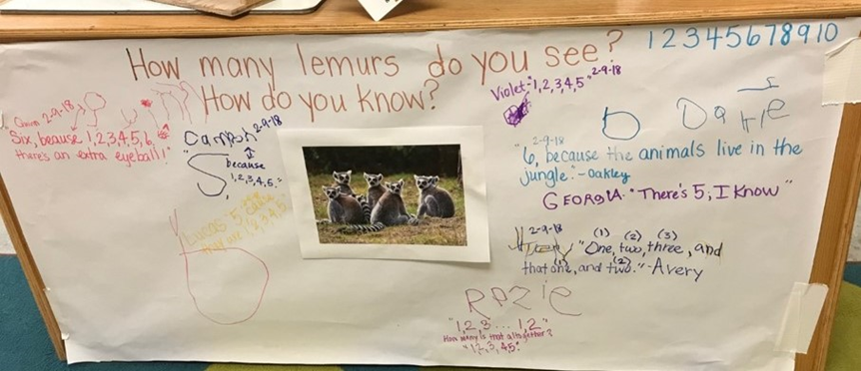

Slide 25
Children should spend most of their day in free play.

Slide 26
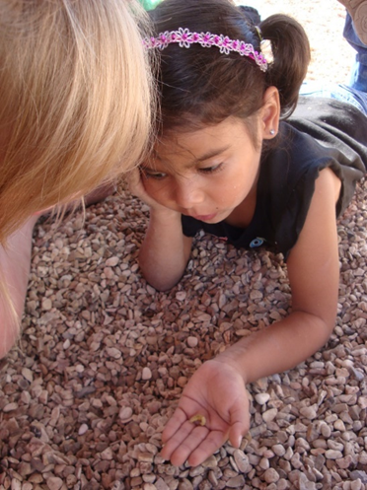

Slide 27
Whole Group Time should be limited.

Slide 28
Providing Leadership for a Quality Program
Just having a program does not prepare children for success.

Slide 29
Additional Resources
A New Push for Play-Based Learning
5 Things Children Learn at Preschool that are a Waste of Time and Not Developmentally Appropriate
Language Exposure Relates to Structural Neural Connectivity in Childhood
Why Pushing Kids to Learn Too Much Too Soon is Counterproductive

Slide 30
Contact/Questions
Janet Rinehart, Director
Missouri Learning Communities Project
(573) 445-7457
jrinehart@cpsk12.org
Lana Brooks, Director
Early Learning, DESE
(573) 751-2095
Lana.Brooks@dese.mo.gov

