Slide 1
Raise Student Achievement Tomorrow
MAESP 2019
Real-Time PD with
Renee Cummins and Laura Watkins

Slide 2
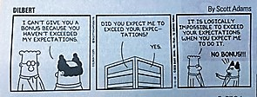
Expectations
Students will rise to your level of expectation.

Slide 3
Session Preview
NEE – Network for Educator Effectiveness
Student Engagement
Indicator 1.2 The teacher cognitively engages students in the content.
Academic Language
Indicator 1.1 The teacher demonstrates content knowledge through the use of academic and disciplinary language and facilitates student's accurate use of academic and disciplinary language.
Critical Thinking
Indicator 4.1 The teacher uses instructional strategies that lead students to problem-solving and critical thinking.
Effective Formative Assessment
Indicator 7.4 The teacher monitors the effect on the whole class and individual learning.

Slide 4
MAP Results
ELA
Percent of Students Scoring Proficient and Advanced
 | insSquared | District | State
2015 | 69.77% | 52.76% | 58.50%
2016 | 82.50% | 62.42% | 63.20%
2017 | 85.42% | 56.52% | 64.20%
Number of Students
2015 – 44
2016 – 40
2017 – 48
Math
Percent of Students Scoring Proficient and Advanced
 | insSquared | District | State
2015 | 63.64% | 34.97% | 49.60%
2016 | 85.00% | 55.45% | 52.50%
2017 | 72.92% | 48.97% | 53.90%
Number of Free and Reduced
47%

Slide 5
Everybody participates!
Student Engagement
SLANT
Transitions
Silent Signals
Not-So-Silent Signals
Accountable Talk

Slide 6
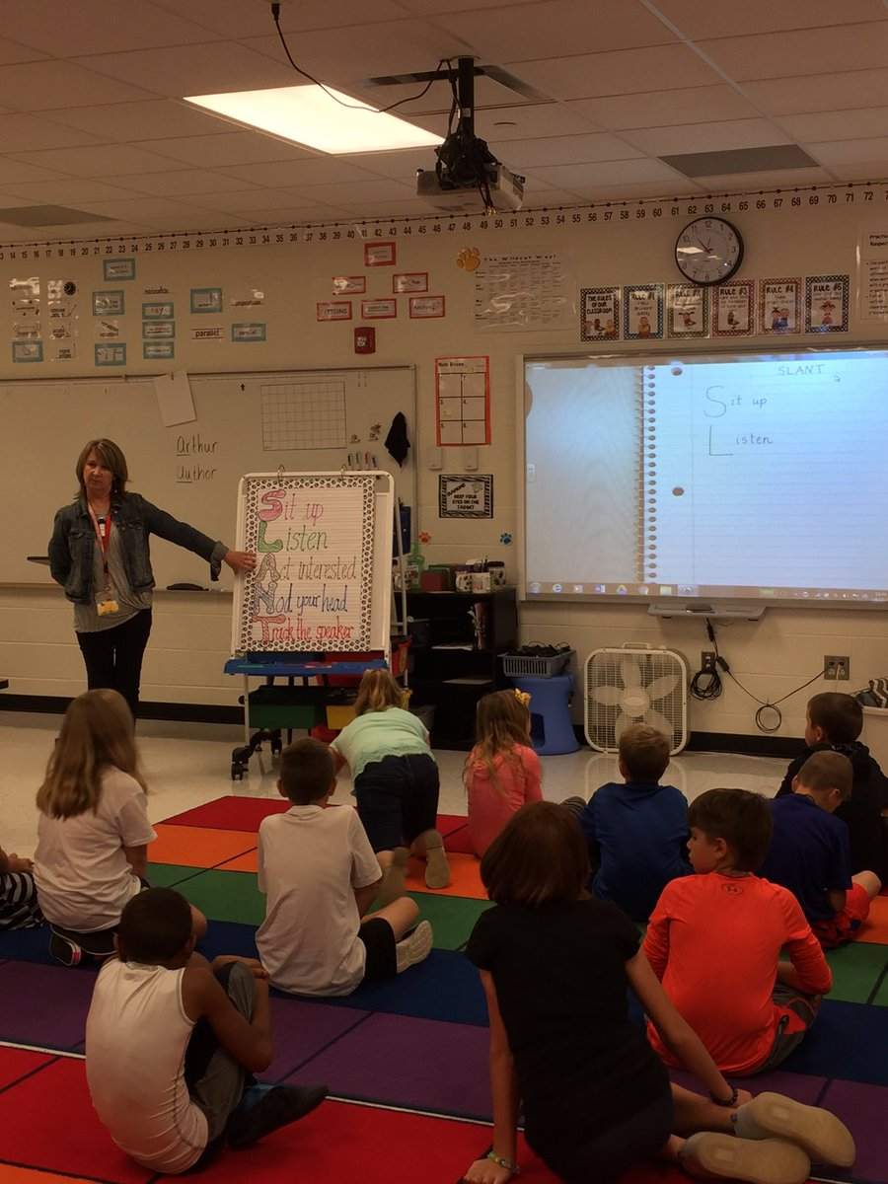
SLANT
Sit up
Listen
Act interested or Ask and Answer ?s
Nod your head
Track the speaker

Slide 7
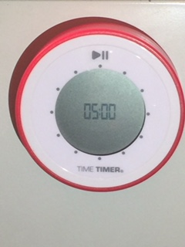
Transitions
Quality Transitions (QT)
“And in this classroom…”
Hands Ready! (Clap)
Timer
Call backs
Freeze!
Red Robin
Hi Ho, Hi Ho

Slide 8
Silent Signals
I agree.
I disagree.

Slide 9
I have an answer.
I would like to add on.

Slide 10
Additional Silent Signals
I’m thinking.
I need clarification.
Conjecture or AHA!
Where’s your bridge?

Slide 11
Not-So-Silent Signals
_______ has the floor.
Stand and answer in a complete sentence

Slide 12
Turn and Talk
C side/W side
Door side/window side
Black side/Gold side

Slide 13
HELP!

Slide 14
The 4L’s of Academic Discourse
Look
Lean
Listen
Lower your voice

Slide 15
Words matter!
Academic Language

Slide 16
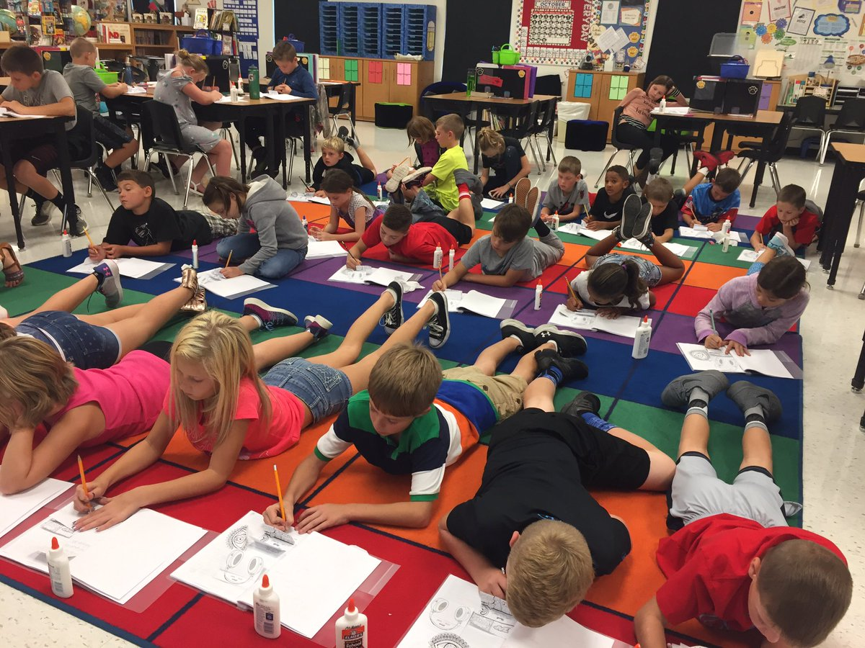
Non-negotiables
Explicit Academic Vocabulary Instruction/Tiered Vocabulary
Greek and Latin Root Instruction
Frayer Models

Slide 17
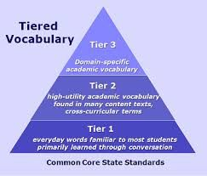
Academic Language
Up the ante with explicit vocabulary instruction!

Slide 18
Examples of Frayer Models

Slide 19
Going Deeper!
Critical Thinking
Wait Time
(Help Option)
Types of Questions
Depth of Knowledge (DOK)

Slide 20
Wait Time
Typical ___________________
Causational _______________
Optimal __________________
1.5 seconds
3-5 seconds
45 seconds
Tic Tock Tic Tock

Slide 21
Types of Questions
Right There
Text _____________________
____________ words are in the question
Usually _________ sentence
explicit
Answer
in one
LITERAL

Slide 22
Types of Questions
Think and Search
Text ___________
Answer words ____ be in the sentence
Answer in ______________ place
explicit
may
more than one
LITERAL

Slide 23
Types of Questions
Text and Me
Text _________
Answer requires _______________________
Uses _____knowledge
implicit
reading between the lines
prior
INFERENTIAL

Slide 24
Types of Questions
On My Own
Answers are ______ in the text
Answers go ________________
Uses _____ knowledge
not
beyond the page
prior
EVALUATIVE

Slide 25
DOK Depth of Knowledge
Difficulty vs Complexity
Is it all about the VERB?
Increase Rigor

Slide 26
Difficulty vs Complexity
Let’s look at the verbs.
Difficult
Read Chapter 12 in your social studies textbook. Identify and list all the reasons Thomas Jefferson had for deploying The Corps of Discovery.
Complex
Identify one reason Thomas Jefferson sent The Corps of Discovery to the Louisiana Territory and using evidence from the text, explain why he thought Meriwether Lewis was the best-suited person to lead the expedition.

Slide 27
Show me!
Effective Formative Assessment
Alternatives to Worksheets

Slide 28
Self-Assessment
3-2-1 Bins
Self-drawn score boxes

Slide 29
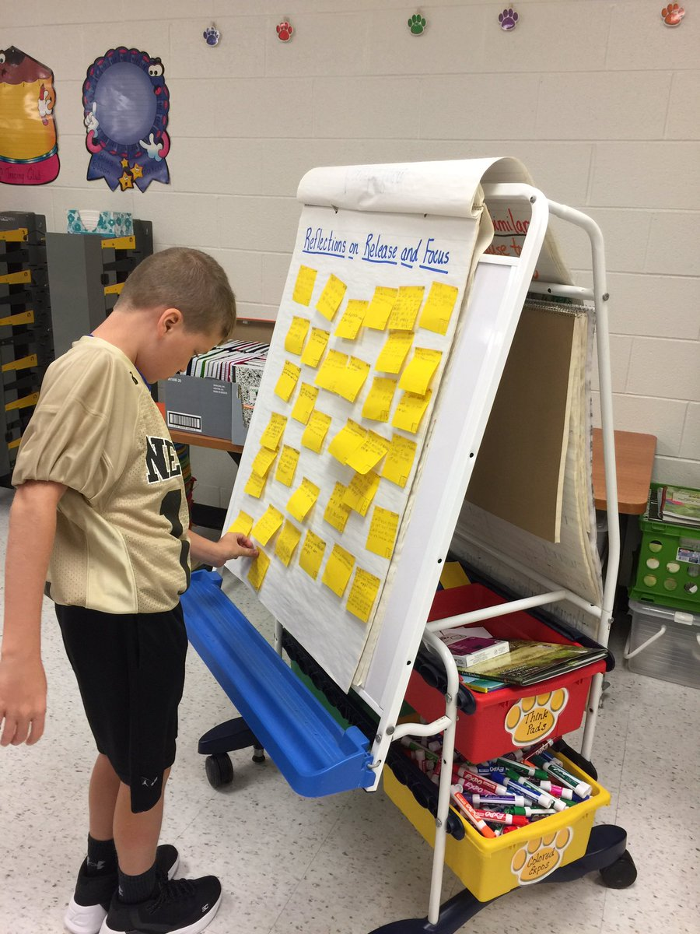
Post-It Notes

Slide 30
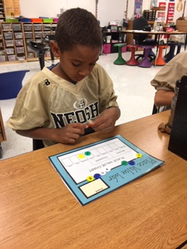
Whiteboards
Games

Slide 31
Digital Alternatives
Seesaw
Flipgrid
ReadWorks
Socrative
Plickers
Kahoot
Quizlet
Xtra Math
Mentimeter

Slide 32
Real-Time PD
with
What topics can I choose from?
Improving student engagement
Formative assessment
Developing higher-order thinking skills
Efficient classroom management
Effective use of small groups
Specific curricular areas
New teacher workshop

Slide 33
Real-Time PD
with
What will this cost me?
Half days
One, two, or three - $479 per ½ day
Four or more - $379 per ½ day
Full days
One - $879
Two or three - $779 per day
Four or more - $669 per day

Slide 34
Real-Time PD
with
Contact us:
treneecummins@gmail.com
laurawatkins2002@gmail.com
3goldengoats@gmail.com
Follow us:
The Golden GOATs @goldeng.o.a.t.s
The Golden GOATs @thegolden_GOATs

